Slide 1
Opening Our Eyes
Student Debt

Slide 2
Team Tuition
Our esteemed panel
Key Note:
Mark Colip, OD – President of the Illinois College of Optometry
Debt to income ratio in optometry
Panelists:
Justin Griest, MEd – Admissions, Recruitment & Financial Aid Officer, OSU College of Optometry
Debt levels from other professions and perspectives
Danica Marrelli, OD, FAAO – Assistant Dean of Clinical Education, University of Houston College of Optometry
Current student views on the issue
David Heath, OD, EdM, FAAO – President, SUNY College of Optometry
Supply & demand or Are there jobs?

Slide 3
Data on the ASCO Website
https://optometriceducation.org/wp-content/uploads/2018/05/ASCO-Student-Data-Report-2017-18.pdf
Average Direct Expenses Over Time
Average Indebtedness Over Time - does not include data on students from Canada

Slide 4
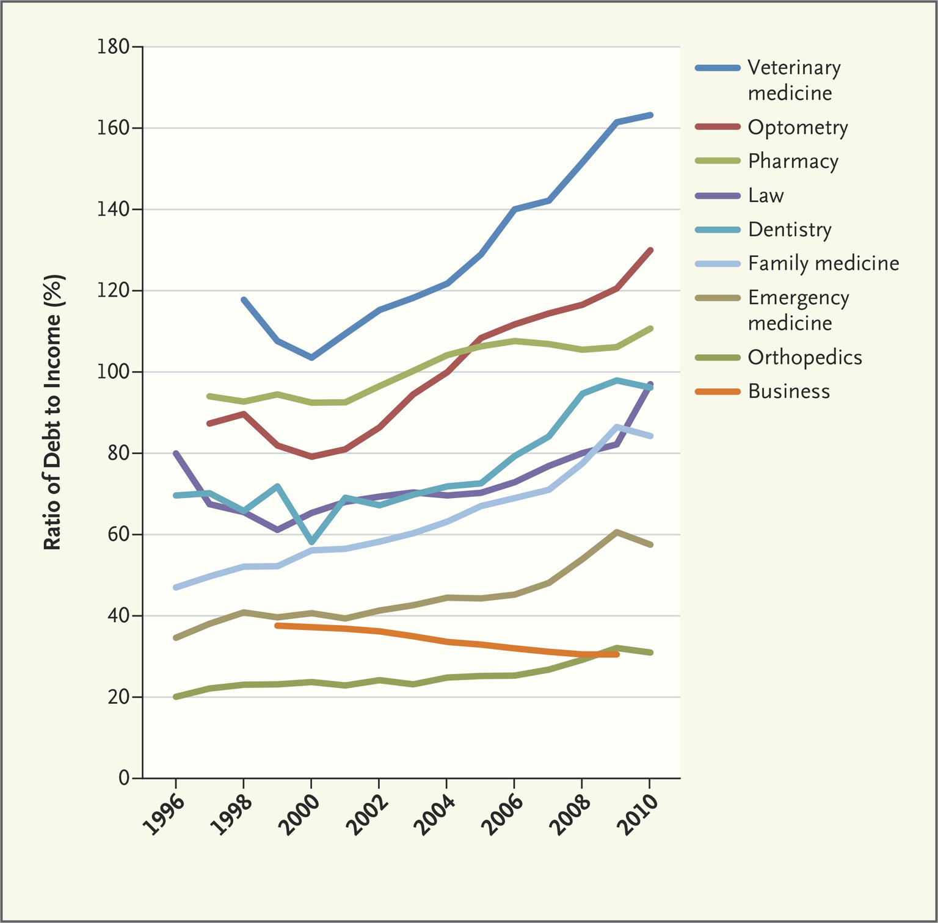
The Tulip Article
Is the debt to income ratio unsustainable?
NEJM Opinion Piece
Optometry had the second highest debt to income ratio
Notes:
Compared to 7 other health professions, business and law
Actual salary data not provided – but cite Current Population Survey – BLS monthly survey of households - this only captures employed optometrists
Leaves out self-employed
Disparity between BLS data and what the AOA provided in 2012 $109K versus range of $129 - $203 K
Source of student debt is not listed

Slide 5
Keynote Address: Student debt – the facts
Mark Colip, OD
President, Illinois College of Optometry

Slide 6
Student DebT
Pay homage to article referenced
Student debt in national perspective
OD student costs of acquisition – changes with time
OD student debt “averages”
How OD graduates are managing student debt – federal programs
Repayment scenario for an “average” graduate

Slide 7
NEJM – Asch, Nicholson, Vujicic (Nov. 2013)
“Bubble markets” premise – 1636 tulip-bulb prices in the Dutch market
Related to US housing bubble and dot-com bubble (both recovered nicely since)
Applied same logic to select US professional health careers (+Business and Law)
Difficult and highly variable sources for stats. (indebtedness and starting income)
I personally feel decisions of which health profession to pursue are much more complex than which tulip to buy……

Slide 8
Association of Governing Boards (AGB) Data (2018)
$1.48 trillion – total student debt
$1.021 trillion – total US credit card debt
$28,650 – average student indebtedness (2017)
49.9% - average freshman discount rate all undergrads.
$57,617 – Median US household income (2017)

Slide 9
Non-housing Debt Balances – by category
https://www.newyorkfed.org/microeconomics/hhdc.html

Slide 10
Housing and Non-Housing Debt Balances
https://www.newyorkfed.org/microeconomics/hhdc.html

Slide 11
Debt 90+ Days Deliquent
https://www.newyorkfed.org/microeconomics/hhdc.html

Slide 12
National Student Loan Cohort Default Rates

Slide 13
AGB 2018 Trustee Index
“The majority of Trustees believe the general public holds positive opinion of higher education’s overall value, but issues such as affordability and student debt continue to erode public trust in higher education.”

Slide 14
FT Enrollment - ASCO
Enrollment 07-08 17-18 Increase
1st Year 1,486 (17) 1,925 (23)
2nd Year 1,363 (17) 1,815 (22)
3rd Year 1,371 (17) 1,700 (21)
4th Year 1,375 (17) 1,684 (21)
Total 5,595 7,274 30%
Does not include students enrolled in alternate or special OD programs

Slide 15
Average Tuition, Fees, Books – over 4 years (resident)
08-09 17-18 Increase %
Public $85,102* $123,496** 45%
Tuition $63,564 $106,614
Fees $11,828 $6,052
Books $9,710 $10,830
Private $113,419 $159,303 40%
Tuition $100,683 $146,784
Fees $1,813 $3,025
Books $10,923 $9,494
*non-resident add approx. $16K
**non-resident add approx. $15,300

Slide 16
Average Living Expenses – (9 mo)
08-09 16-17 Increase
Public $14,559 $18,645 28%
Rent/Food $9,282 $12,482
Health Ins. $803 $936
Transp. $2,061 $2,349
Misc. $2,413 $2,878
Private $16,610 $17,562 6%
Rent/Food $11,060 $11,581
Health Ins. $1,401 $1,913
Transp. $1,659 $1,664
Misc. $2,490 $2,404

Slide 17
Grants/Scholarships in OD Programs
07-08 16-17 Increase
Total Awards $9.1M $12M 32%
URM $276,526 $493,814
Avg./#/% N/A $5,310/93/1.3%
School/Institutional $5.7M $8.7M
Avg./#/% N/A $4,497/1,952/27.4%
Other Grants/Scholarships $3M $2.8M
Avg./#/% N/A $7,392/381/5.3%

Slide 18
State Contracts and Federal Work-Study
07-08 16-17 Change
State Contracts $6.5M $5.8M -10%
$8,905/729/12% $14,337/407/5.7%
Federal Work-Study $1.9M $2.3M +21%
$1,364/1,404/23% $1,715/1,351/19%

Slide 19
Loan Assistance – 51% Increase in total
07-08 16-17
Volume $169,880,204 $258,044,665
Program Avg. Loan Amnt/#/% receiving Avg. Loan Amnt/#/% receiving
Perkins $3,894/2,223/37% $4,161/1,175/16.5%
HHS Health Prof $4,630/944/16.9% $5,044/1,129/15.9%
Federal Direct Loan $24,402/4,436/79% $38,370/5,433/76%
Unsubsidized
Federal Graduate Plus $8,714/4,683/84% $14,739/2,348/33%
Subsidized
Institutional Loans $1,648/322/5.8% $5,248/125/1.8%
HHS Loans for Disadvantaged $2,610/64/1% $3,448/70/1%
Other Loans $14,917/476/8% $17,118/204/2.9%

Slide 20
Indebtedness of Graduates – ASCO
07-08 16-17 Increase
# w/ Debt 1,069 1,136 6.3%
% w/ Debt 78% 79.4% 1.4%
Average Debt $132,630 $174,165 31%
+Avg Undergrad debt +$15,703 +$26,865
(27% - 405*) (48% - 617)
* 6 schools did not report

Slide 21
Student Loan Repayment options (1)

Slide 22
Student Loan Repayment options (2)

Slide 23
$200K Loan Repayment scenarios
$200,000 Loan Balance
$102,000 Starting Salary
5% Annual Income Growth
https://studentloans.gov/myDirectLoan/repaymentEstimator.action

Slide 24
Addressing the issue in the recruiting process
Justin Griest, MEd
Admissions, Recruitment & Financial Aid Officer The Ohio State University College of Optometry

Slide 25
Savvy Consumers
Preparing for the Cost of Optometry School
A majority of students entering our optometry schools today start with very little knowledge of loans or being financially independent
Why?
Full-on focus on admissions process
Very little loan debt from undergrad
Upon OPT entrance AY17 - undergraduate debt - $12,829
Parents “oversee” the financial situation
Students have little or no credit and don’t understand the totality of debt and/or managing money
Notes:
What do you think the number 1 question, or more over OBSESSION a prospective student concentrates on when looking at the profession?
How do I get in – Admissions, Admissions, Admissions.
Very rarely will the first questions from students concentrate on cost of attendance. This is not at the forefront of their thought process – they just want to know how to get in.

Slide 26
Our Responsibility
Schools & Colleges of Optometry
Starts with early education (before OPT School) of the investment and lifestyle necessary to not drown in debt:
Visit Day Events
Webinars
Educating gatekeepers (Parents, OD Mentors, Undergrad Advisors)
Full detail of cost of attendance
A student can control their own living expenses
Notes:
Often times students concentrate on tuition/fees and not the whole picture – instruments, boards, expenses during externships, cost of living (get a roommate and live within your means) (a $2 coffee today, could turn into a $20 coffee down the road)

Slide 27
Keys to Success
Band of Resources
Financial Aid Offices:
One-on-one meetings
Acceptance webinars
Tips for budgeting and living within your means
Explanation of loan repayment plans and options
Networking events with upper class students
Notes:
What do financial aid offices do to support students?

Slide 28
Keys to Success
Band of Resources
Financial Wellness at Ohio State
Scarlet and Gray Financial uses trained volunteer peer coaches to offer 1:1 financial wellness appointments in the Student Life Student Wellness Center. Coaching meetings are appointment-based and free.
Financial coaches can assist with the following topics:
Banking basics
Budgeting
Credit card selection, use and repayment
Debt repayment planning
Financing your college education
Planning for major purchases
Student loans
Understanding retirement and savings
Understanding your credit report and score
Notes:
Key Opportunities to support students

Slide 29
Importance
Financial Wellness
Financial Stress: The increasing costs of education, living expenses, and overall debt
Results related to financial stress among college students:
Academic letdown
Reduction of course load & withdrawal
A worsening GPA & fewer hours earned
Undesirable health: obesity, lack of physical activity, harmful diets, alcohol and drug use
Suicide
Notes:
Why is it important to manage financial stressors? Staff Psychologist

Slide 30
Success
Loan Repayment – Ohio State annual loan default rate by program
 | 2012 | 2013 | 2014 | 2015
Medicine | 0.50% | 0.50% | 0.00% | 1.70%
Optometry | 0.00% | 0.00% | 0.00% | 0.00%
Pharmacy | 2.20% | 0.00% | 0.80% | 0.70%
Veterinary Medicine | 0.83% | 0.00% | 0.00% | 0.00%

Slide 31
Student survey
Danica J. Marrelli, OD, FAAO
University of Houston College of Optometry

Slide 32
SURVEY MONKEY
STUDENTS AT UHCO AND PACIFIC UNIVERSITY COLLEGE OF OPTOMETRY
Eleven questions
Average 3 minutes
198 responses from each school

Slide 33
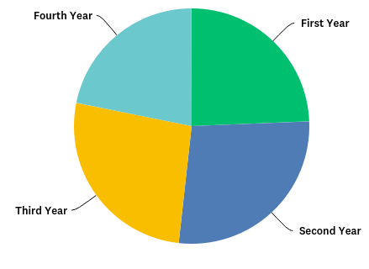
QUESTION 1
WHAT YEAR OPTOMETRY STUDENT ARE YOU?
UHCO
PACIFIC U

Slide 34
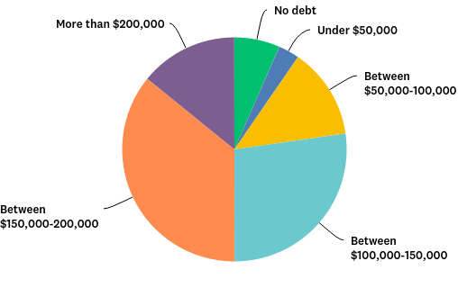
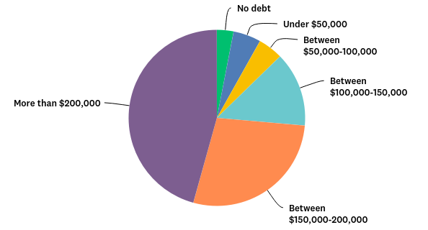
QUESTION 2*
TOTAL ANTICIPATED STUDENT LOAN DEBT
PACIFIC U
UHCO
Notes:
UHCO 50.26% REPORT $150,000 OR MORE
PACIFIC 73.61% REPORT $150,000 OR MORE
NO DEBT – 6% (UH) VS 3% (PACIFIC)

Slide 35
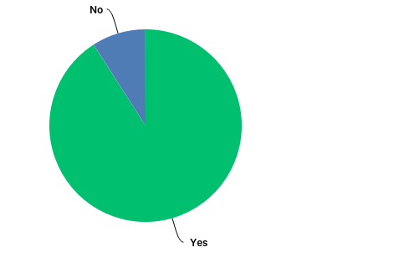
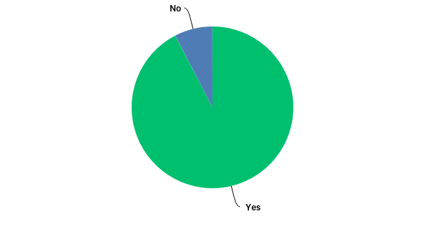
QUESTION 3
WERE YOU AWARE OF THE COST AT THE TIME YOU APPLIED?

Slide 36
QUESTION 3
WERE YOU AWARE OF THE COST?
“YES, BUT…”
DIDN’T CONSIDER THE IMPACT OF THE CANADIAN EXCHANGE RATE
UNAWARE OF COSTS OUTSIDE TUITION/FEES (EQUIPMENT, DUES, NBEO, MOVING FOR EXTERNSHIP SITES, ETC)
THE COSTS CONTINUE TO INCREASE *****
UNAWARE THAT DIFFERENT YEARS HAVE DIFFERENT COSTS
I DIDN’T KNOW HOW MUCH THE INTEREST WOULD BE
IT’S SIGNIFICANTLY MORE THAN I ANTICIPATED
UNDERESTIMATED HOUSING/LIVING COSTS
EXPECTED MORE SCHOLARSHIPS
“I KNEW IT WOULD BE EXPENSIVE, BUT DAMN, NOT THIS MUCH”

Slide 37
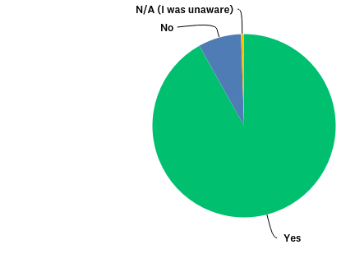
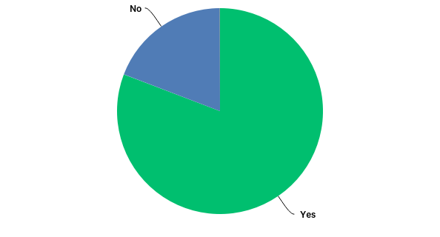
QUESTION 4
AT THE TIME THAT YOU APPLIED, DID THE COST CONCERN YOU?

Slide 38
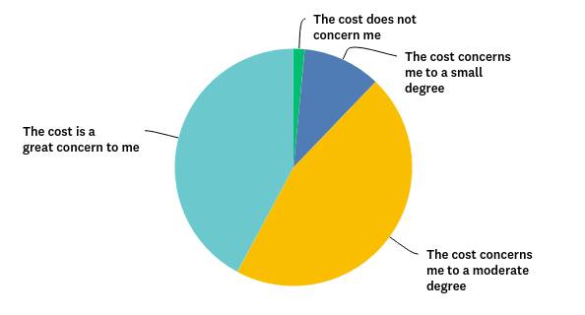
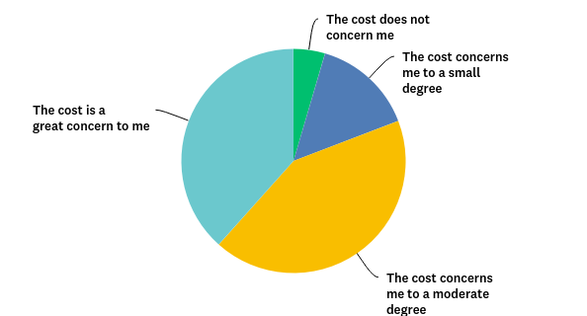
QUESTION 5
AT THIS TIME, DOES THE COST CONCERN YOU?

Slide 39
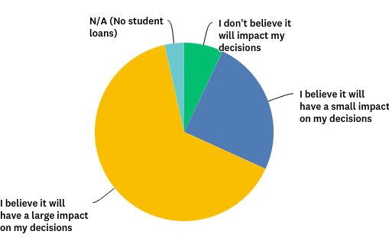
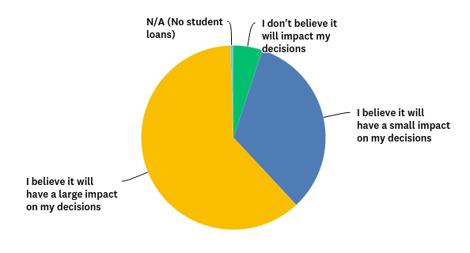
QUESTION 6
TO WHAT EXTENT DO YOU THINK THAT YOUR STUDENT LOAN DEBT WILL IMPACT YOUR PRACTICE DECISIONS AFTER GRADUATION?

Slide 40
QUESTION 6
TO WHAT EXTENT DO YOU THINK THAT YOUR STUDENT LOAN DEBT WILL IMPACT YOUR PRACTICE DECISIONS AFTER GRADUATION?
PRIVATE PRACTICE ISN’T FEASIBLE****
I CANNOT CONSIDER APPLYING FOR RESIDENCY****
SALARY IS TOP FACTOR (OVER LOCATION AND DESIRABLE SITUATION)***

Slide 41
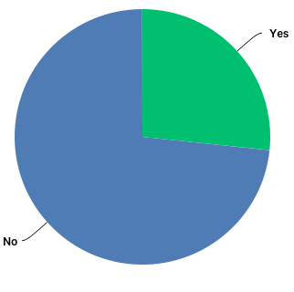
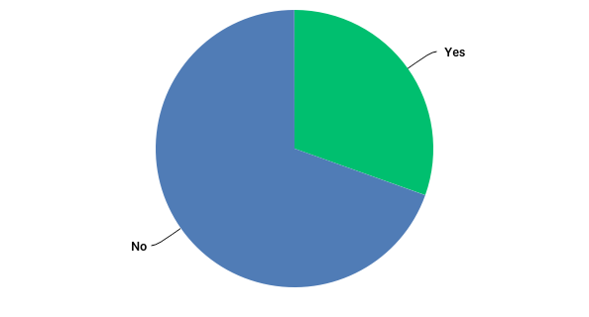
QUESTION 7
DO YOU FEEL THAT YOU HAVE RECEIVED AMPLE GUIDANCE REGARDING STUDENT LOANS?

Slide 42
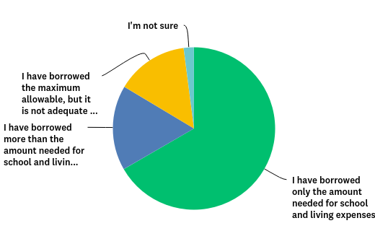
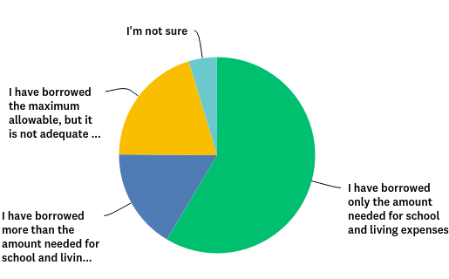
QUESTION 8
WHICH BEST REPRESENTS YOUR BORROWING HABITS?

Slide 43
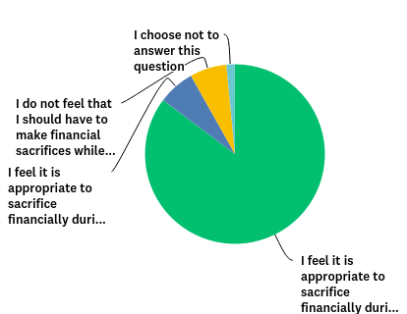
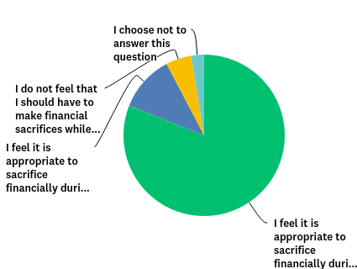
QUESTION 9
HOW DO YOU FEEL REGARDING FINANCIAL SACRIFICES DURING SCHOOL?
Notes:
ABOUT 5% SAID THEY DID NOT FEEL THEY SHOULD HAVE TO MAKE SACRIFICES DURING SCHOOL

Slide 44
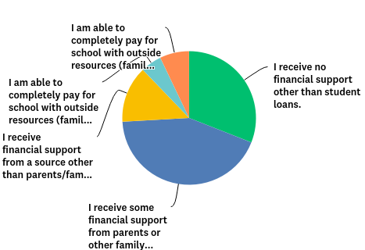
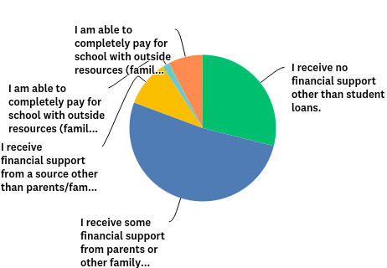
QUESTION 10
TO WHAT EXTENT DO YOU RECEIVE SUPPORT OTHER THAN STUDENT LOANS?
Notes:
ABOUT 30% SAID THEY RECEIVE NO SUPPORT OTHER THAN STUDENT LOANS
THE LARGEST PORTION SAID THEY RECEIVE SOME FAMILY SUPPORT IN ADDITION TO LOANS

Slide 45
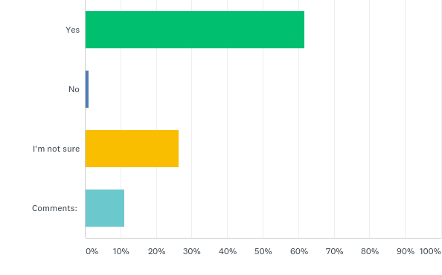
QUESTION 11
DO YOU BELIEVE THAT AN OPTOMETRIC CAREER IS WORTH THE FINANCIAL INVESTMENT?
Notes:
69% YES
1% NO
30% NOT SURE

Slide 46
“Supply & Demand” or “Are there Jobs?”
David A. Heath, OD, EdM, FAAO
President
State University of New York College of Optometry

Slide 47
Optometric Education Today: Graduation Rates & Projections
AY 2018: 1,643 grads
#2
#3
#4
AY 1999: 1,350 grads
#1
Note # 1: 2013 - AZ, WUCO, UIWRSO
# 2: 2015 - MCPHSU
# 3: 2020 - Pikeville
# 4: 2021 - Chicago

Slide 48
Optometric Education Today: Graduation Rates & Residency Positions (28%)
#3
#4
AY 1999: 1,350 grads
#2
28%
#1
21%
Note # 1: 2013 - AZ, WUCO, UIWRSO
# 2: 2015 - MCPHSU
# 3: 2020 - Pikeville
# 4: 2021 - Chicago

Slide 49
% Change in Graduation Rate v. US Pop.
From 1999 – 2018:
Annual incr. grads = 1.25%
Annual incr. US pop. = 0.8%
Note # 1: 2013 - AZ, WUCO, UIWRSO
# 2: 2015 - MCPHSU
# 3: 2020 - Pikeville
# 4: 2021 - Chicago

Slide 50
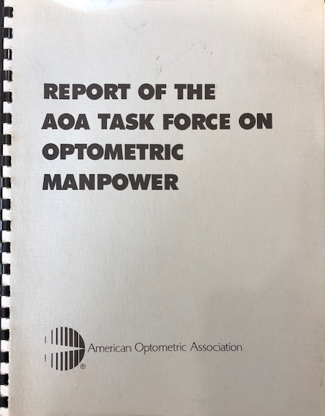
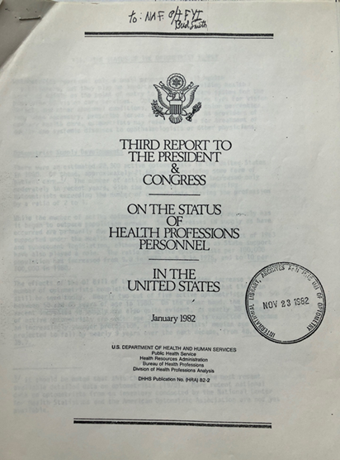
Optometric Manpower Projections: 1982
Supply in 1978: 21,133
Projected Supply in 1990: 27,200*
Projected Demand in 1990: 36,000
Projected Shortfall in 1990: 9,000
Report projects that if Optometry provided
“all of primary eye/vision care needs in the future”, in 1990, there would need to be 76,334 optometrists.
* U.S. Department of Health and Human Services Report , 1982

Slide 51
Optometry Manpower: 2000 - The Abt Report Doomsday???
Supply in 1997: 30,500
New Grads: 1,125*
Est. Annual Retirements: 550
(By 2015 – 820/yr)
Projected an excess of 2,500 by 2005 and suggested the largest excess supply would be between 2013 – 2018, topping 4,000.
* Excludes foreign students receiving an OD

Slide 52
Eye Care Workforce Study” 2014 - The Lewin Study
Supply in 2012: 39,580
New Grads in 2012: 1,404
(Projected 1,800 by 2019)
Projected a base shortage of eye care providers of 2,900 in 2020.
Project an excess of 10,900 when accounting for “Total Excess Capacity”.

Slide 53
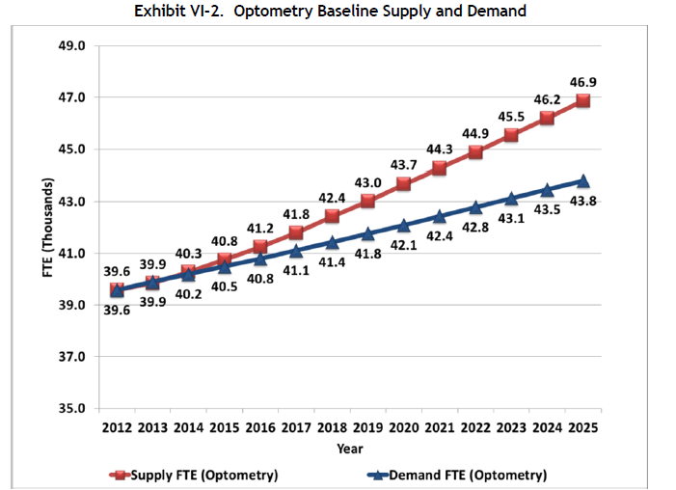
Lewin Study: Supply & Demand/Utilization
2012 Assumption: Supply = Demand

Slide 54
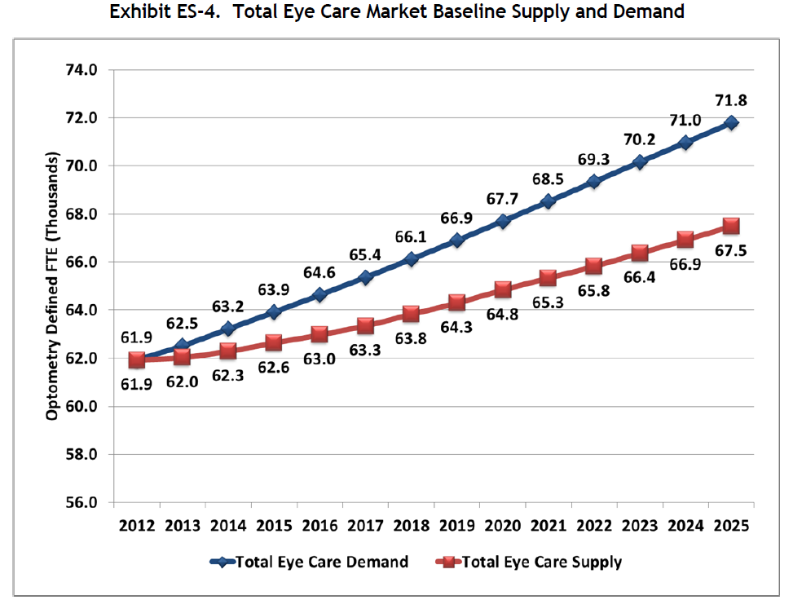
Lewin Study: Total Supply & Demand/Utilization

Slide 55
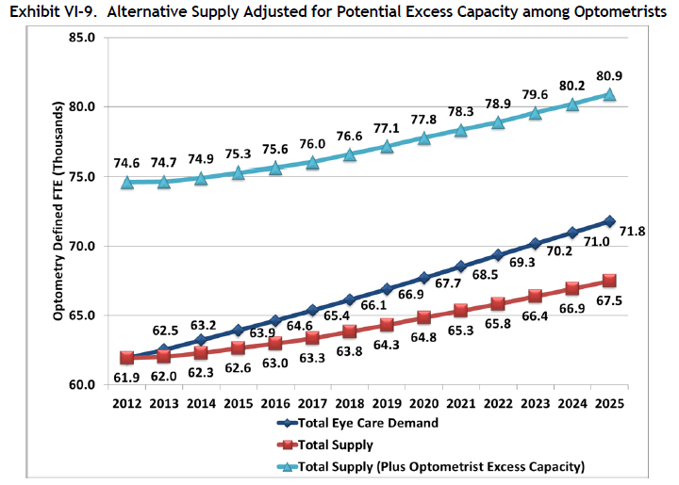
The Magic of Excess Capacity
Q: How many additional visits could you provide per week, without expanding hours, if you were fully booked with zero no shows?
Potential 32% increased capacity
Assumed an extra 20 patients per OD per week and 100% participation
2017 Assessment (manuscript in process) – refined the line of inquiry and found “likely excess capacity” to be around 3 - 4 more patients per week or approx. 5% additional capacity.

Slide 56
Are there jobs?
Salary Estimates:
AOA = $139K
Glass Door = $132K
Salary.com = $121K
BLS = $110K
Default rates < 1%?
BLS: 2016 – 2026 = 18% projected growth (faster than average)
Are there unemployed ODs?
SUNY – Alumni Surveys: No unemployment
2016 – 2026 BLS Projections:
OD = 18%
DDS = 19%
DVM = 19%
MD = 13%
PA = 37%
PharmD = 6%
RN = 15%
SUNY

Slide 57
Anecdotal Evidence - iHireOptometry?
Recruiting Technology
Job Seekers & Employers
Identified Trends
16,200 job openings linked to title of “optometrist”
Top locations: California, Florida, Texas, New York and Illinois
Top cities: Chicago, Richmond, Phoenix, NYC and Houston
On the website: Click on ”Optometrist” – 2,382 job postings
On the website: Click on “Ophthalmologist – 375 jobs postings
Website - claims there are 1,437 employers Industry-wide looking
Source: https://invisionmag.com/ihireoptometry-puts-market-growth-in-focus-at-seco-2019/
www.ihireoptometry.com/

