Slide 2
Scope Practiced vs. Scope of Practice

Slide 3
Distinguished Panel

Slide 4
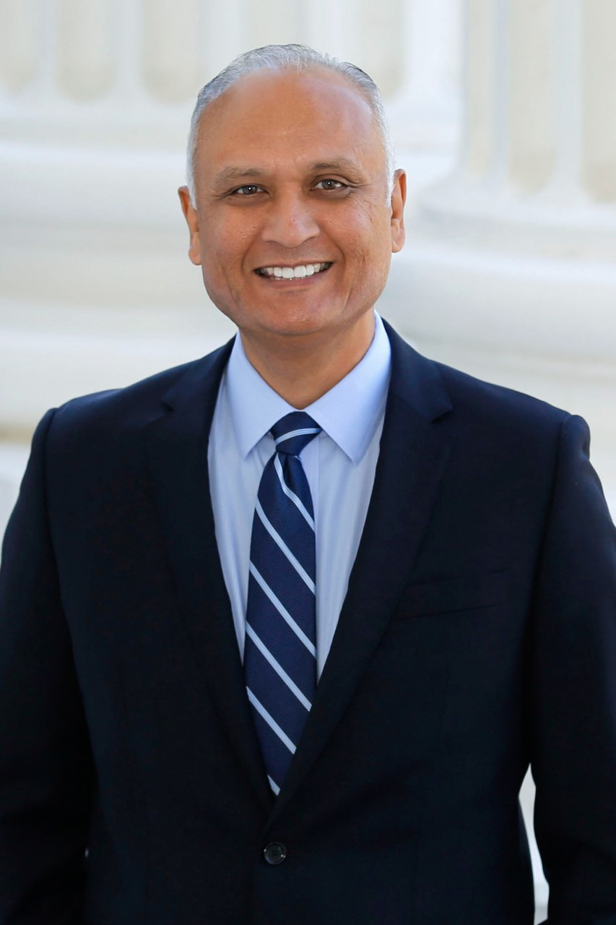
Keynote Presenter Dr. Ed Hernandez
Perspectives
Private Practice
State Board
State Legislature
Policy
Externship Education

Slide 5
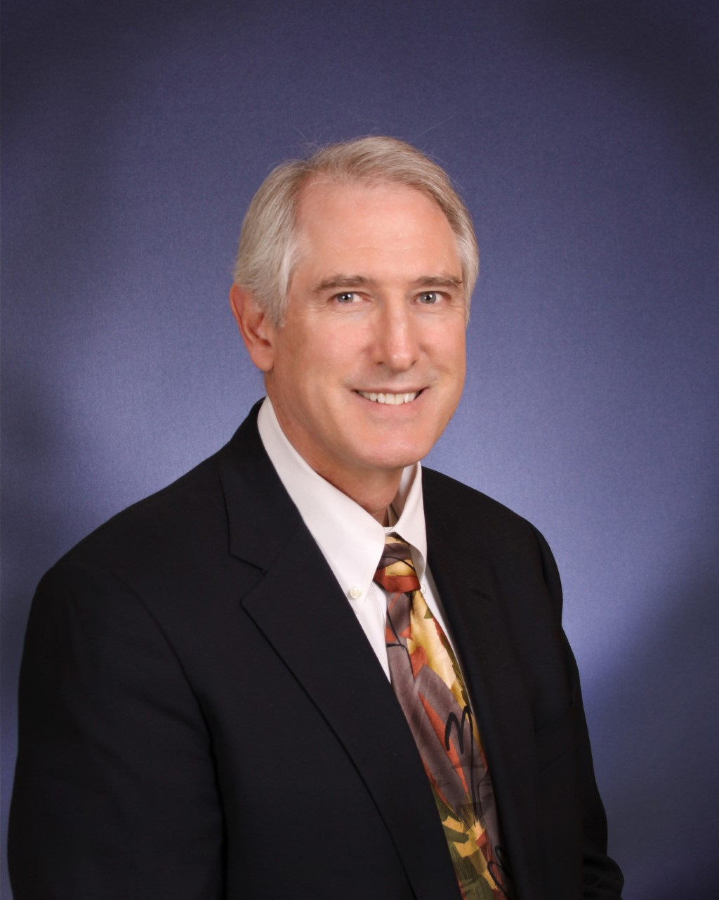
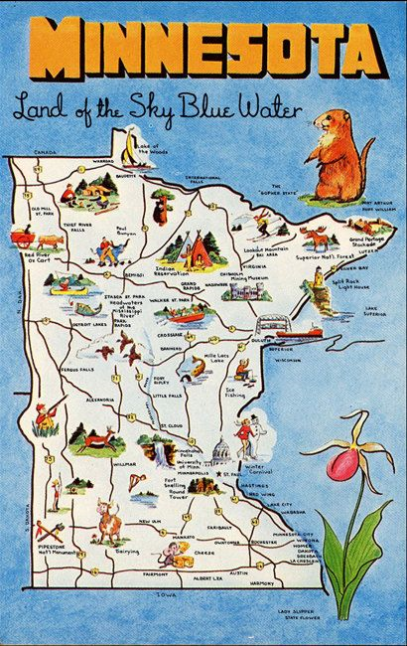
Dr. Patrick O’Neill
Perspectives
Private Practice
State Association
Regional Association
State Board
Regulatory
Externship Education

Slide 6
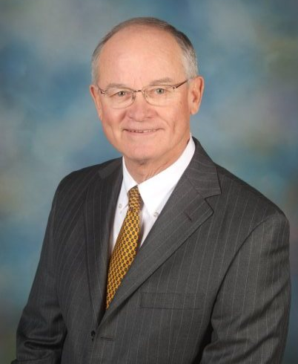
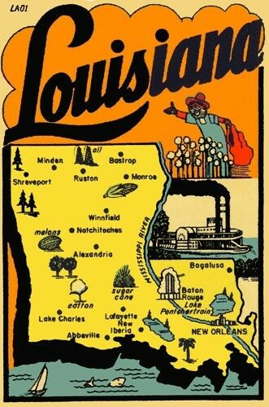
Dr. James Sandefur
Perspectives
Private Practice
State Board
State Association
Legislative Advocacy
SCO Board of Trustees

Slide 7
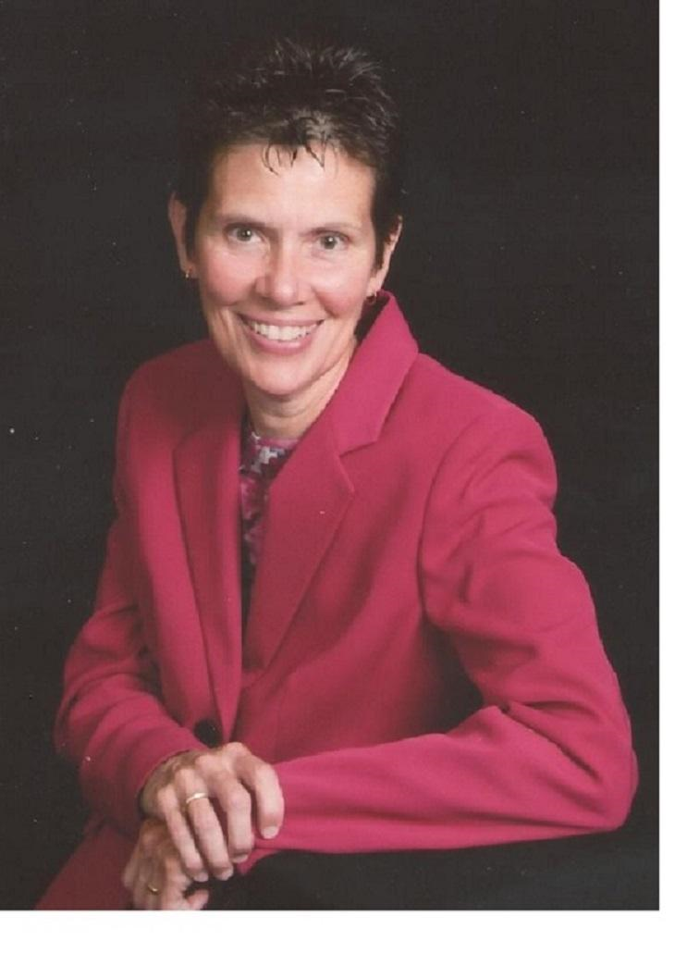
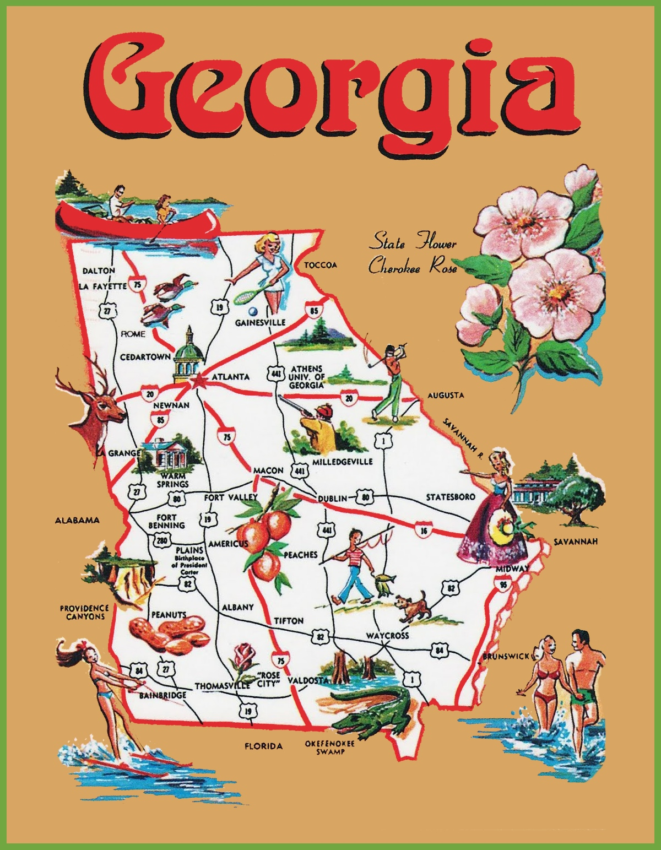
Dr. Tammy Than
Perspectives
Education
Author
Department of Veterans Affairs
Advanced Medical Practice

Slide 8
As we look to the future…
Are we more effective uniting with a concentrated focus on scope expansion?
Is there room under the tent for any and all perspectives on scope?
Is our professional role “broad and shallow” or “narrow and deep”?
What about sub-specialties?
What about “traditional” professional roles?
What happens after graduation?
What partnerships will get us where we need to go?
How are we going to pay for all of this?

Slide 9
Scope Practiced vs. Scope of Practice
Edward P. Hernandez, O.D.

Slide 10
California Scope of Practice in 1986

Slide 11
SCOPE PRACTICED vs. SCOPE OF PRACTICE
California 1986
Doctors of Optometry were only allowed to use diagnostic pharmaceutical agents (DPA)
Doctors of Optometry were not legally allowed to make a medical diagnosis
Optometric technicians were not legally allowed to perform pre-testing

Slide 12
“not all states are created equal”

Slide 13
Scope Practiced vs Scope of Practice
Scope Today
Advanced Surgical
Lumps and Bumps
State Authorized Procedures
Rx Controlled Substances
Rx Hydrocodone
Oral Steroids
Oral Immunosuppressive
Oral Anti-fungal
Glaucoma Authority
Injectable Authority
Diagnostic Testing
In-office Blood Testing
Vision Rehab/Therapy
Punctal Plug and Foreign Body Removal
Vaccines

Slide 14
Race to the top led by individual states

Slide 15
“we as doctors of optometry live and practice in a parallel universe”

Slide 16
Scope Practiced vs Scope Practiced
Startling Statistics
In contrast to education provided at optometry schools and colleges, the Lewin Workforce Study reported that only 20-35% of optometrists practice full-scope care.

Slide 17
“schools and colleges of optometry are not always included in the scope of practice conversation”

Slide 18
Which direction should our profession head, and who should lead?

Slide 19
Scope Practiced vs Scope of Practice
Which direction?
Advanced surgical procedures?
Cataract surgery?
Retina surgery?

Slide 20
Should the profession of optometry move in a different direction?

Slide 21
Scope Practiced vs Scope of Practice
Different direction?
Primary care?
Vaccines?
Chronic disease management?
Diabetes?
Diabetic educators?
Tele-Health?
Artificial intelligence (AI) ?

Slide 22
“strategic plan involving all stakeholders”

