Slide 1
Quantity and Quality of Optometry’s Applicant Pool
Lewis Reich, OD., Ph.D.
Southern College of Optometry

Slide 2
Background
Some background - I have been working in the applicant pool space for a some time:
ASCO’s OAT liaison from 2006-2014.
Chair, OptomCAS task force and Implementation Committee 2009-11.
When I first began presenting on concerns regarding the size and quality of our applicant pool some years ago, response was lukewarm. More recently, these discussions have taken on a greater sense of urgency.

Slide 3
Outline: Metrics that will be discussed
Number of applicants and matriculating students in entering optometry classes post OptomCAS implementation (2010 - current).
Lack of centralization before 2009 led to some inflated estimates, especially in applicant pool estimates.
OAT & GPA performance data.
NBEO implications?
Linked GPA & OAT for entering Fall 2018 matriculants.
Starting in the 2017-18 admissions cycle, OAT data began being imported directly into OptomCAS.
Most of data presented today comes from a paper that Karla Zadnik and I have recently submitted.

Slide 4
Quantity: Applicant pool numbers and matriculating students
.
Entering year | Applicant: matriculant ratio
2010 | 1.53
2018 | 1.39
Peak in 2016 with 2812 applicants,
1871 matriculants (1.5:1 ratio)
2006

Slide 5
Quality: Average Applicant OAT and Undergraduate Grades
Platform change in 2015 permitted more detailed assessment of undergraduate grades
Schools accept students, not averages.
We need to take a closer look at performance within the cohort.

Slide 6
Applicant: OAT Performance
What is a strong applicant?
Dotted line represents the number of matriculating 2016 students (peak).
With the exception of 2016, not enough applicants with scores of 300, or above, to fill every seat.
More than enough applicants with scores of 280, or better.

Slide 7
Applicant GPA Performance
Considering GPA alone, there are enough folks with GPA over 3.0 to fill each matriculating class over the past 4 years.

Slide 8
Applicants and Matriculating Students have decreased over the past 2 years
In 2017, 6 programs collectively reduced class size by 5 to 27 students for an average class size decrease of 12.5% across these programs.
Collectively, 7 fewer matriculants relative to 2017 despite the opening of a new program.

Slide 9
Applicants and Matriculating Students have decreased over the past 2 years
In 2018, 13 schools reduced class size by 3 to 11 seats for an average decrease of 6.5% across these programs.
Lost an additional 42 matriculants compared to 2017.

Slide 10
2016 was the Peak for Applicants and Matriculating Students
Why did some programs not fill classes in 2017 & 2018?
One possible reason is that enhanced ACOE standards state that within 6 years of matriculation, a minimum of 80% of all entering students will be either licensed to practice optometry or be able to be licensed.
ASCO & NBEO also worked together to report NBEO pass rate statistics the past 2 years.

Slide 11
NBEO pass rate statistics
This table includes the average results for all programs:

Slide 12
NBEO pass rate statistics and matriculant qualifications
This table compares the 4 programs with the highest pass rates with the 4 programs with the lowest pass rates in 2018.
 | UPR | GPA | OAT
Top 4 programs | 98.5% | 3.52 | 334
Lowest 4 programs | 77.5% | 3.25 | 308
Using ASCO data from their matriculating classes of 2014, the average GPA and OAT from the top performing programs were distinctly higher.

Slide 13
2017-18 “Linked” GPA & OAT Data
OptomCAS now includes grades and OAT* for each applicant
For the entering class of 2018:
2527 applicants
1934 of these were accepted and,
1822 matriculated.
Acceptance rate of nearly 77%
Classified as “somewhat selective”
Same as the national acceptance rate for community colleges

Slide 14
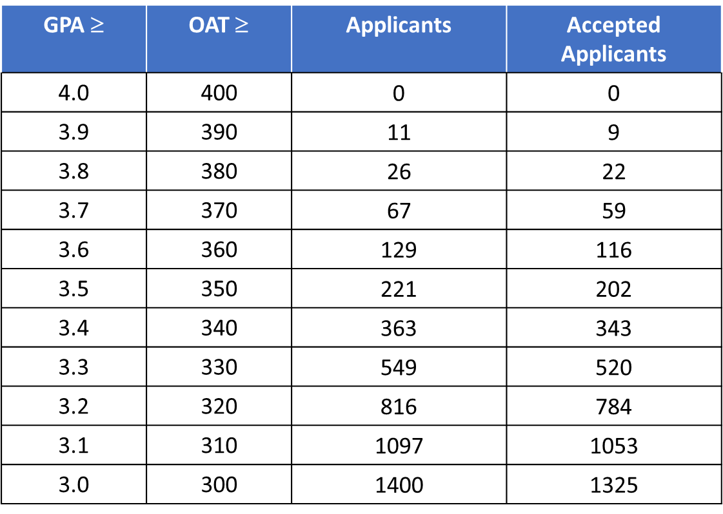
A Closer Look at 2017-18 “Linked” GPA & OAT

Slide 15
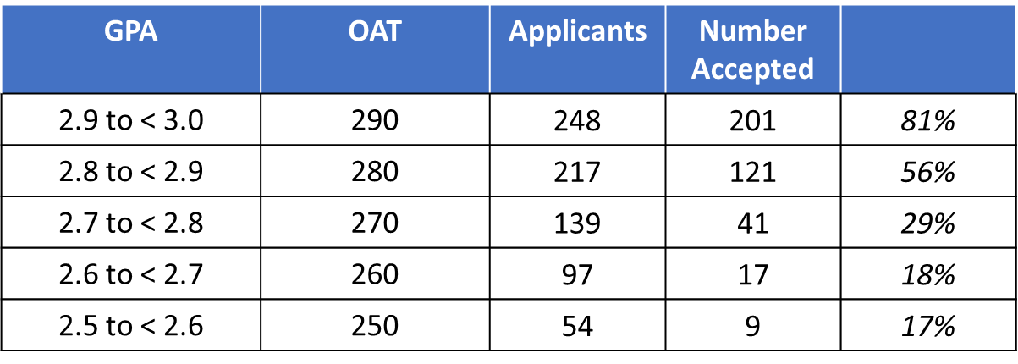
2017-18 “Linked” GPA & OAT Data, continued
Bottom line: There are likely some academically weak students in last fall’s entering class

Slide 16
Balance between GPA and OAT
The examples for the last two slides considered scenarios where OAT scores were 10x larger than GPA (i.e. 300, 3.0)
As a former student affairs officer, if an applicant had a lower GPA, I looked for a higher OAT and vice versa.
For accepted students with: | The corresponding value was:
GPA = 3.0 (2.94 – 3.04) | OAT mean = 310
OAT = 300 | GPA mean = 3.3
GPA
OAT

Slide 17
Conclusions

Slide 18
Conclusions
Some very strong students are entering optometry programs. But with a flat or declining quality of applicant pool, we are experiencing enhanced competition for the strongest candidates.
Applicant pool deficits appears to have implications for filling classes, passing the NBEO sequence, and licensure.
Linking of OAT and GPA should provide more complete applicant profiles going forward
Stakes are high for ASCO’s Optometry Gives Me Life Campaign!

