Slide 1
ASCO Applicant Development Project
Dr. Lewis Reich, Chair of the Applicant
Development Task Force
President of Southern College of Optometry
March 14, 2019
ASCO Board of Directors Meeting

Slide 2
Truth Collective Update – Completed Steps
(July 2018 through February 2019)
  Completed “Optometry Gives Me Life” marketing materials:
  Posters
  Print Ads
  Digital Display Ads
  Owned Social Ads
  Brochure Design
  Opt-in Email/Campaign Emails
  Web Landing Page with Videos – FutureEyeDoc.org
  Brand Toolkit

Slide 3
POsters

Slide 4

Poster 18x24”

Slide 5
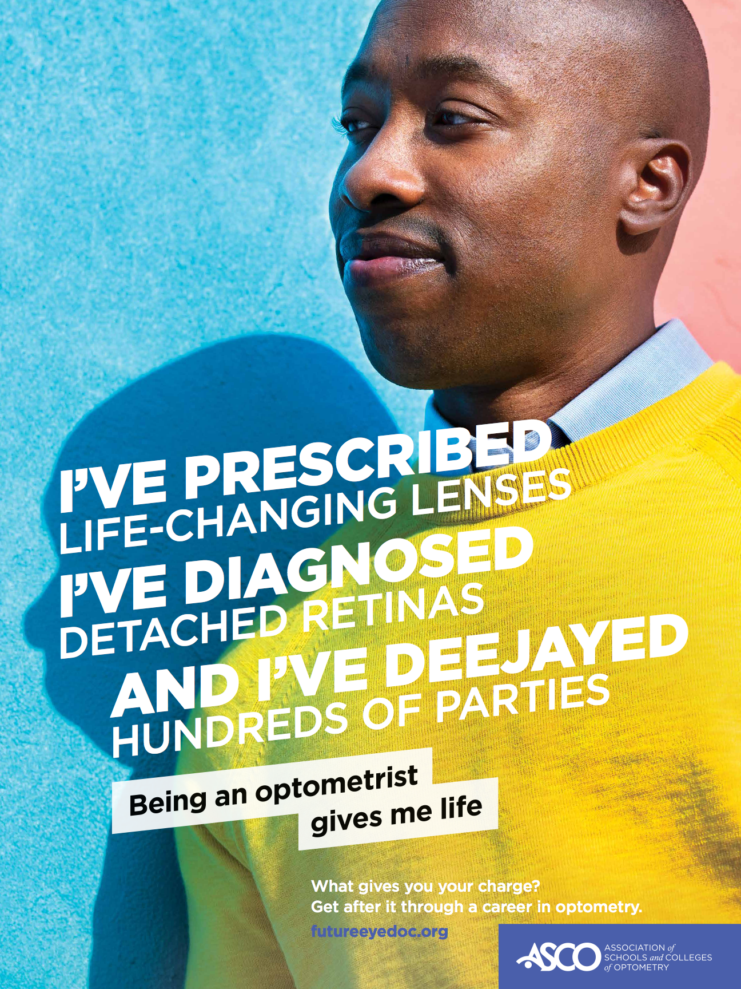
Poster 18x24”

Slide 6

Poster 18x24”

Slide 7
Print Ads

Slide 8
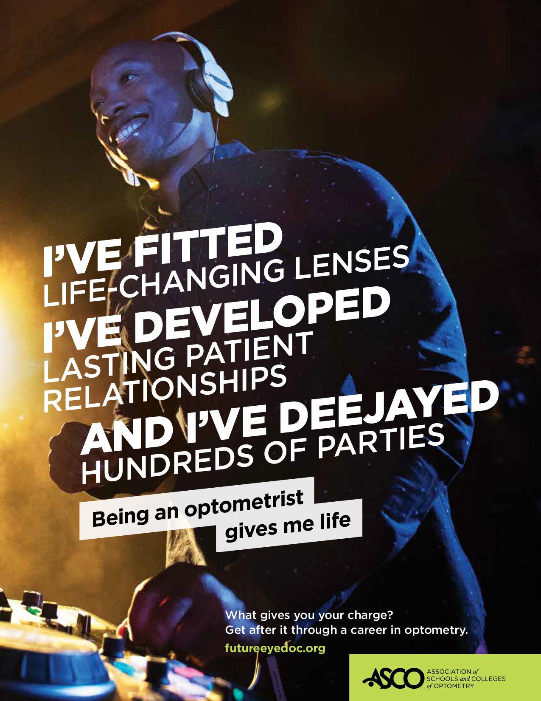
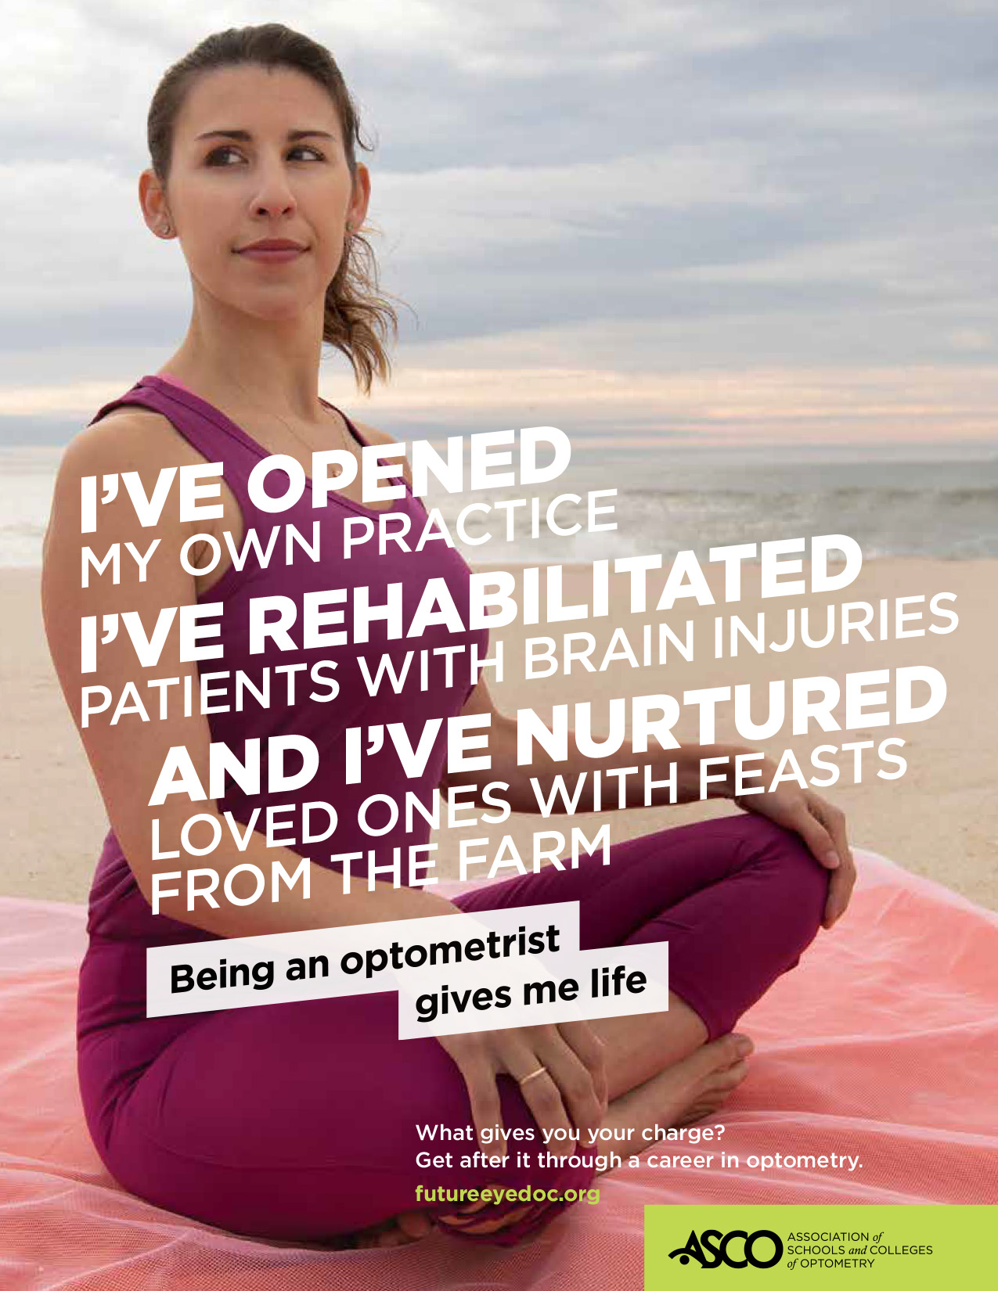

Print Ads 8.5x11
Truth collectiVe

Slide 9
Digital Display Ads

Slide 10


Display ads Banners
300x600
160x600
Truth collectiVe

Slide 11



Display ads Banners
728x90
300x250
320x50 (mobile)
Truth collectiVe

Slide 12
Owned Social Ads

Slide 13
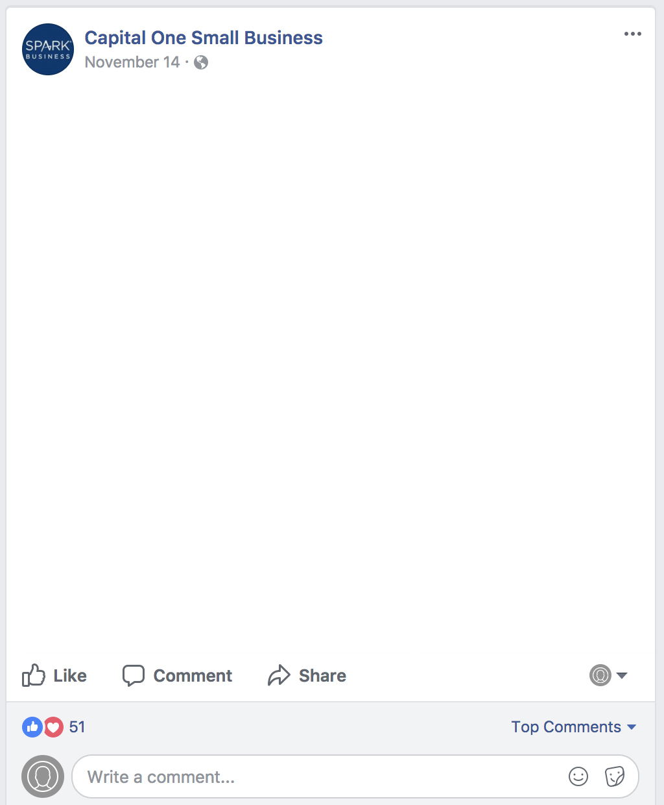
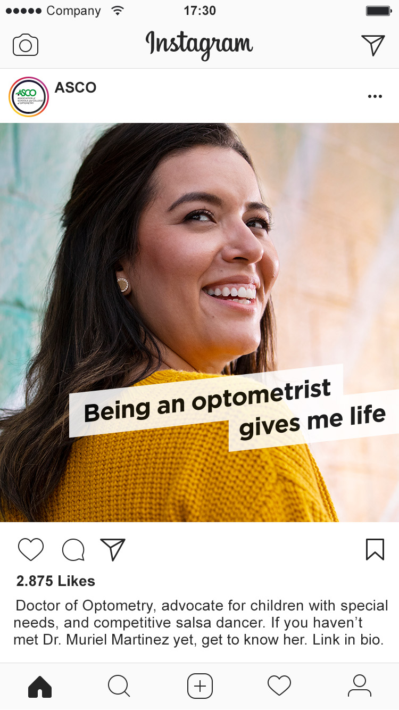

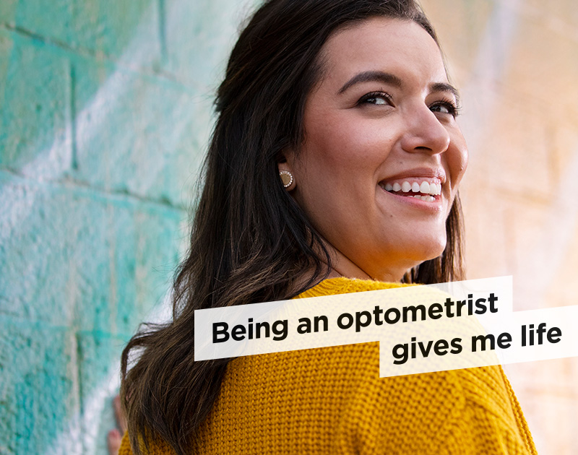
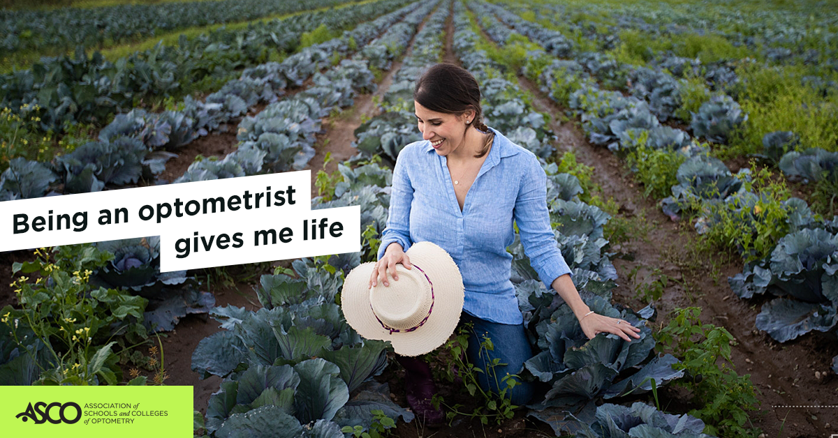
Static
Post
Doctor of Optometry, advocate for children with special needs, and competitive salsa dancer. If you haven’t met Dr. Muriel Martinez yet, get to know her at futureeyedoc.org
Truth collectiVe
Faceboook
Instagram

Slide 14
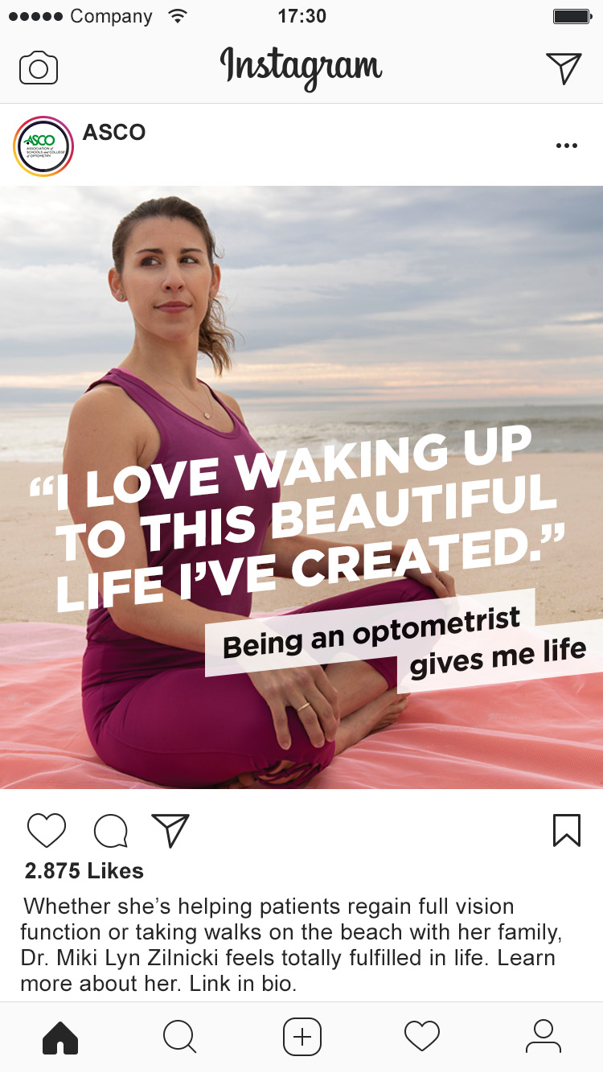
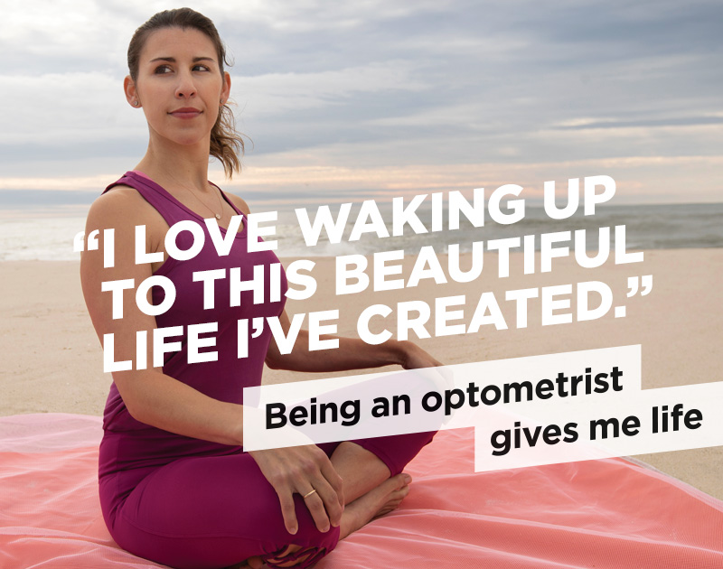
Static
Post
Whether she’s helping patients regain full vision function or taking walks on the beach with her family, Dr. Miki Lyn Zilnicki feels totally fulfilled in life. Learn more about her at futureeyedoc.org
Truth collectiVe
Facebook
Instagram

Slide 15
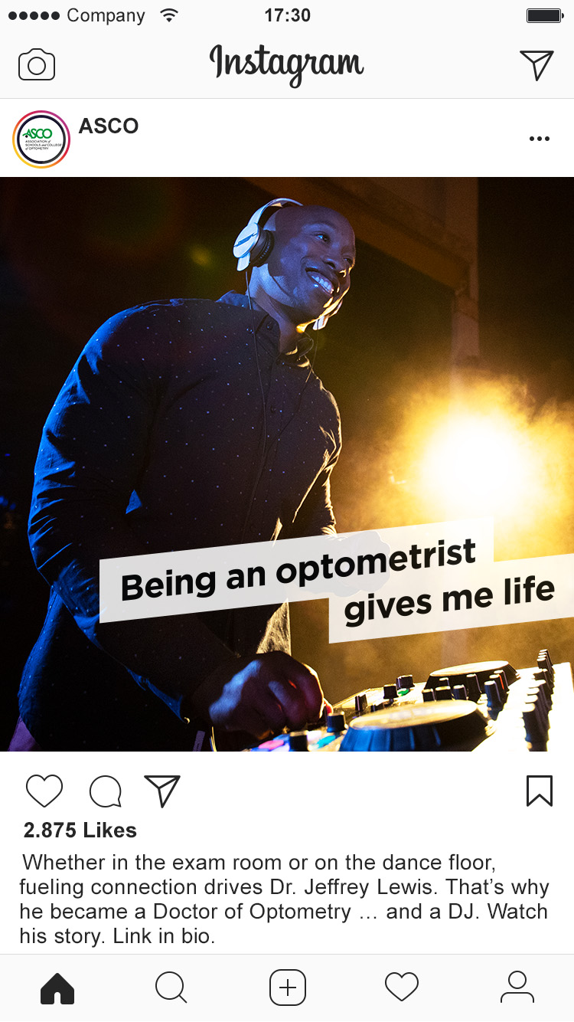
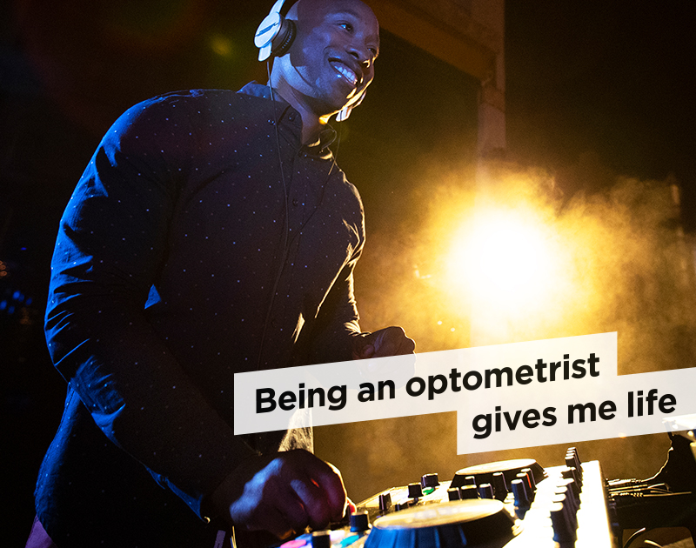
Static
Post
Whether in the exam room or on the dance floor, fueling connection drives Dr. Jeffrey Lewis. That’s why he became a Doctor of Optometry … and a DJ. Get his story at futureeyedoc.org
Truth collectiVe
Facebook
Instagram

Slide 16
Brochure design

Slide 17

Asco | review
cover
(newspaper
9.625” x 13.25” page)
Truth collectiVe

Slide 18

Asco | review
Spread 1
Truth collectiVe

Slide 19
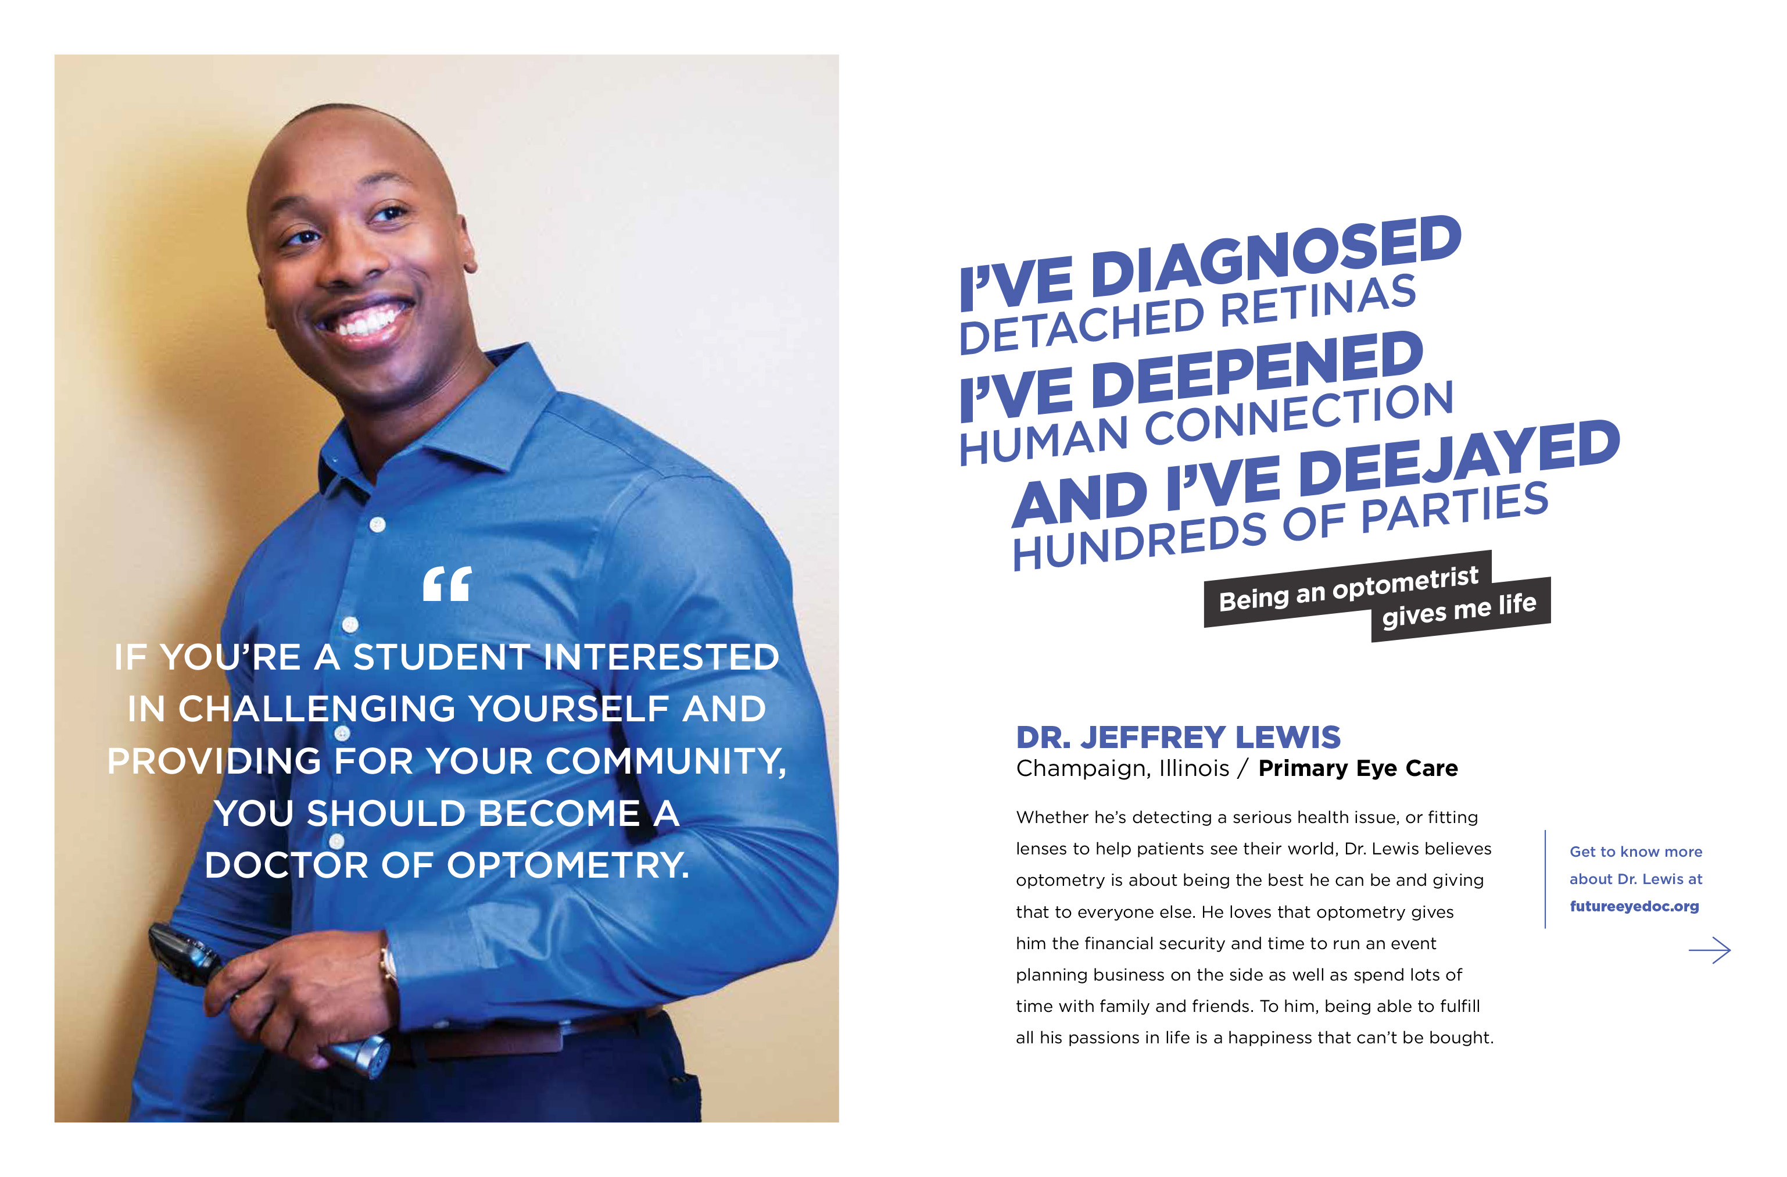
Asco | review
Spread 2
Truth collectiVe

Slide 20
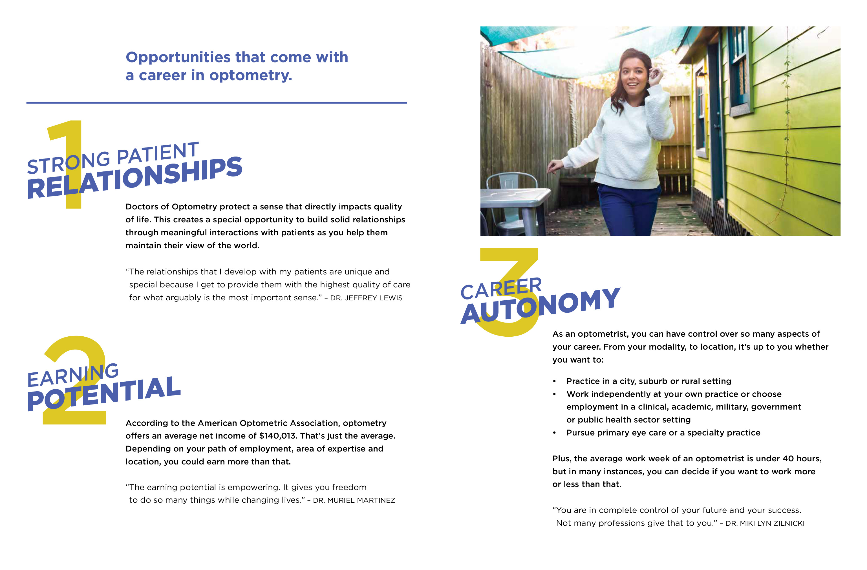
Asco | review
Spread 3
Truth collectiVe

Slide 21
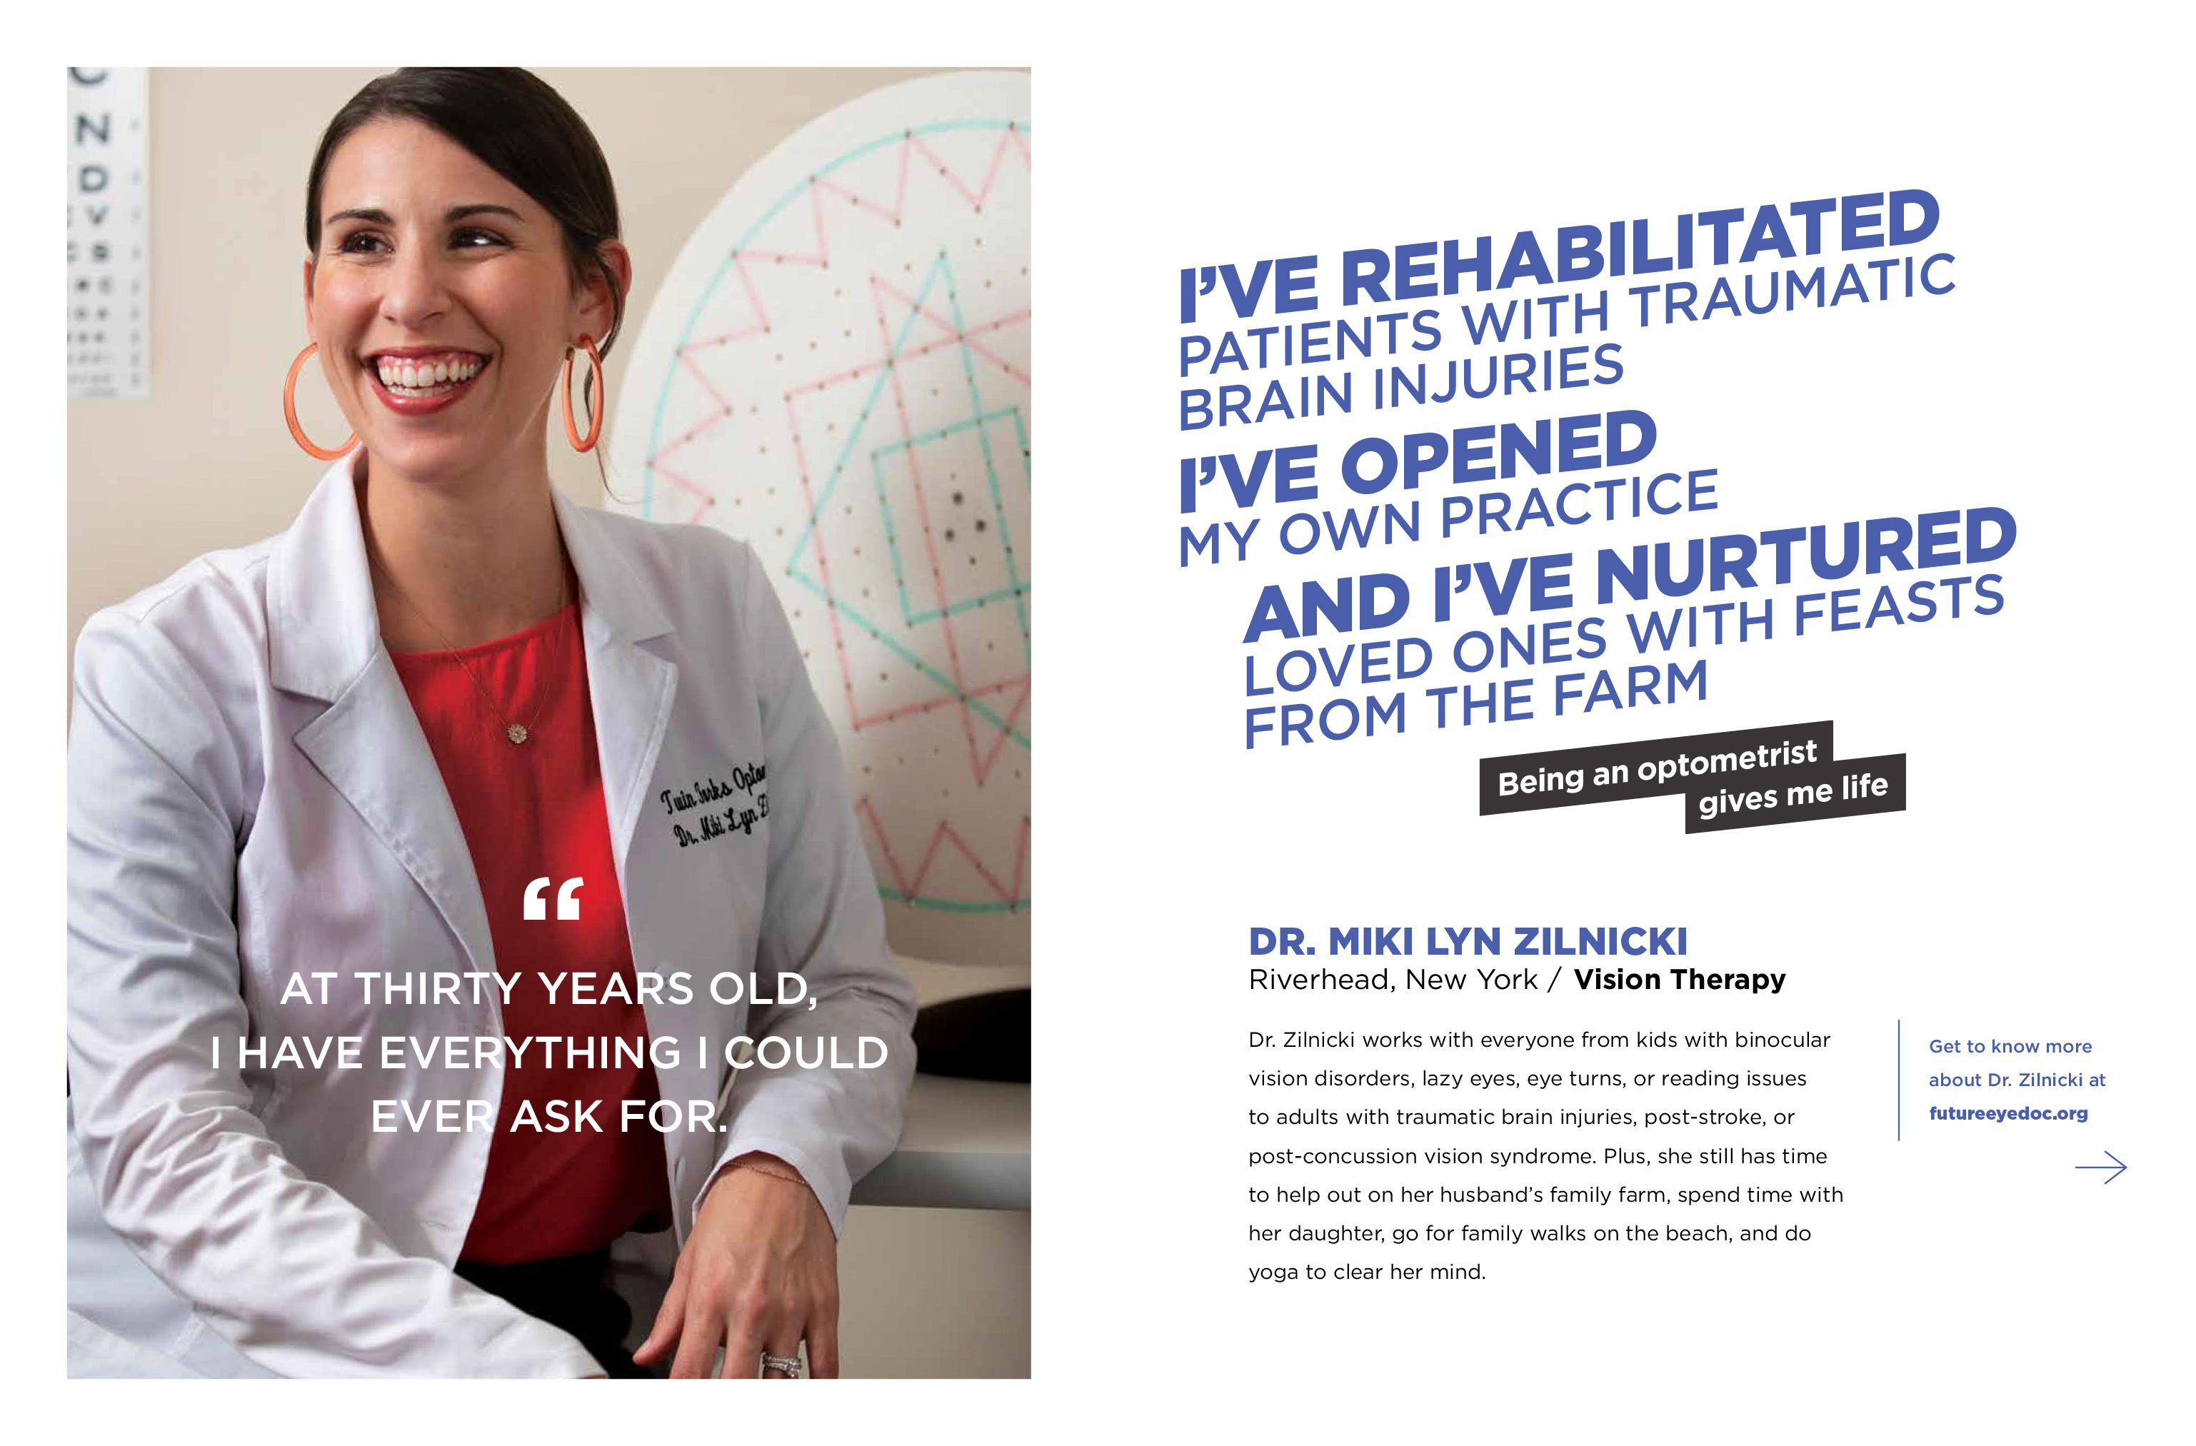
Asco | review
Spread 4
Truth collectiVe

Slide 22
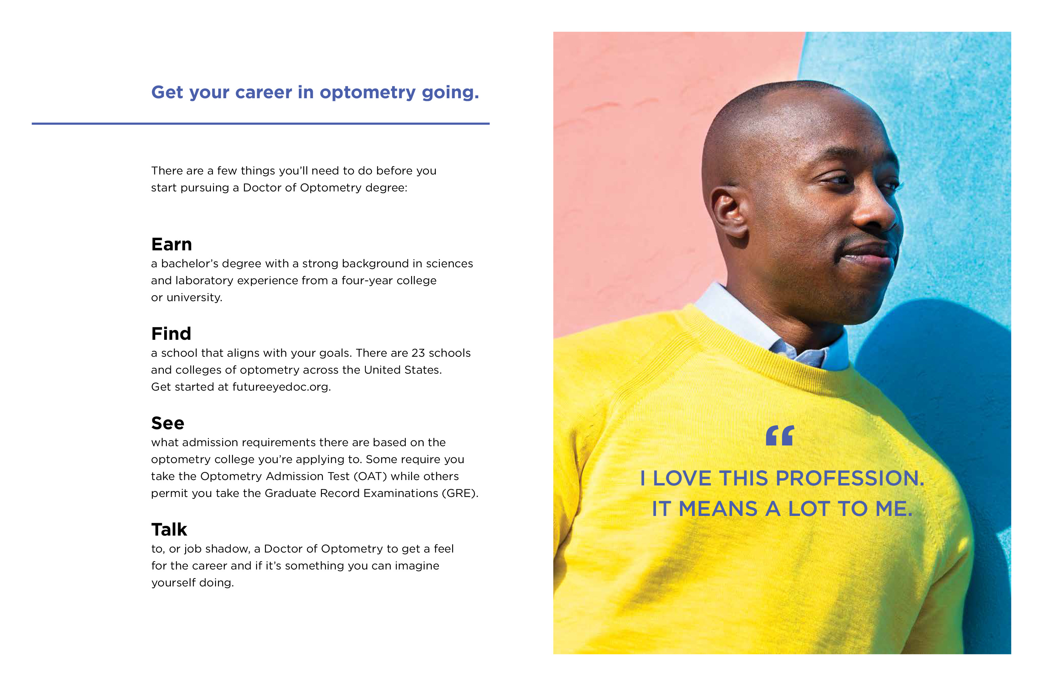
Asco | review
Spread 5
Truth collectiVe

Slide 23
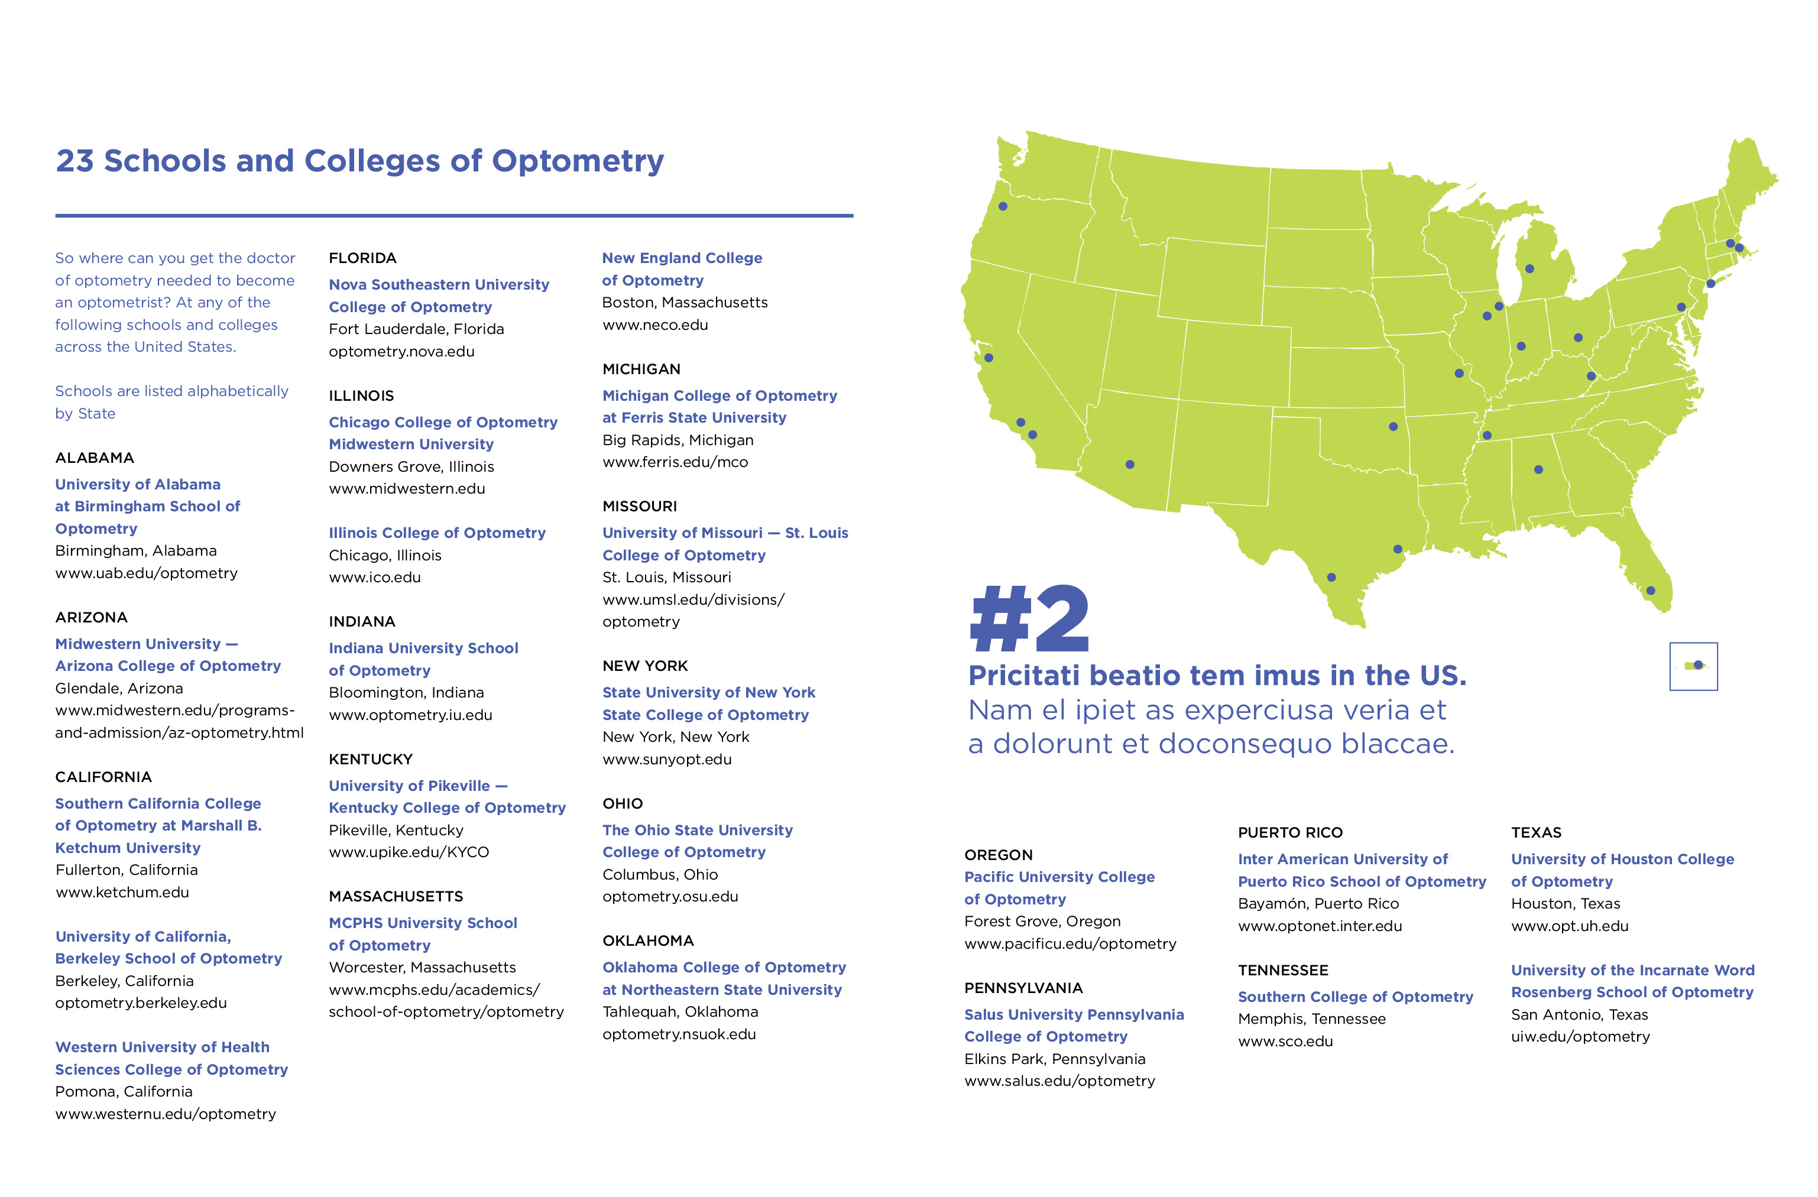
Asco | review
Spread 6
Truth collectiVe

Slide 24
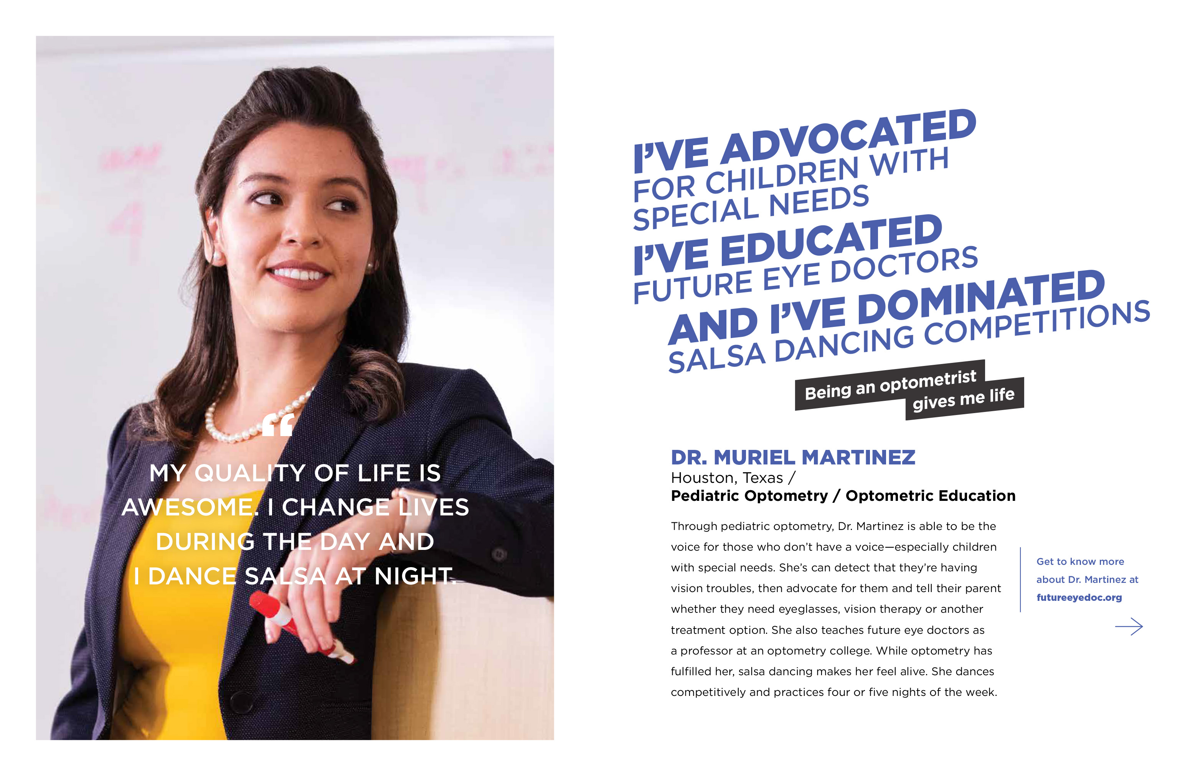
Asco | review
Spread 6
Truth collectiVe

Slide 25
Asco | review
Back cover
Truth collectiVe

Slide 26


Asco | review
Design (newspaper)
Mocked up (folded)
Truth collectiVe
Mocked up (unfolded)

Slide 27
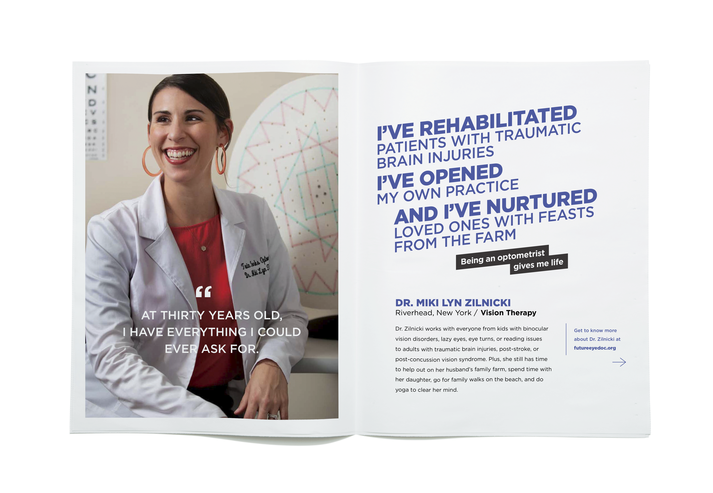
Asco | review
Design
(newspaper)
Truth collectiVe
Mocked up

Slide 28
Web landing page

Slide 29
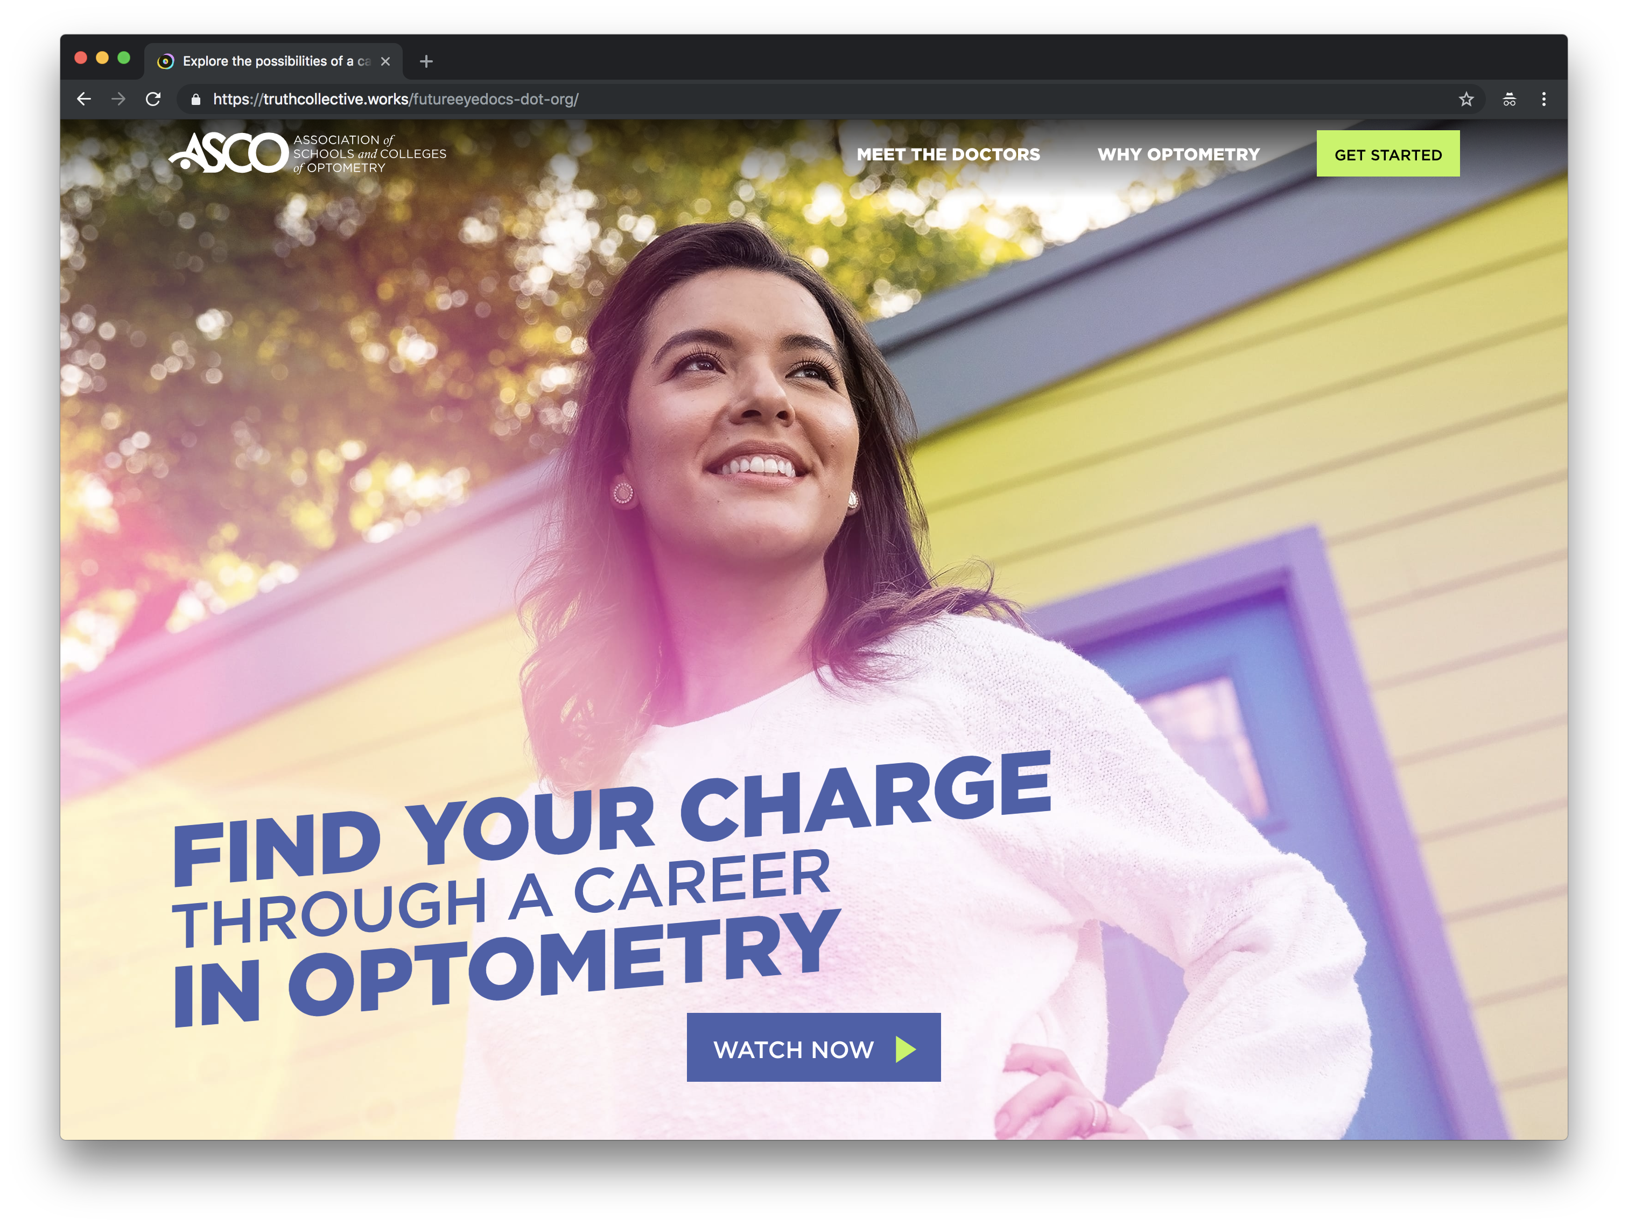
Asco | review
Landing Page
Live site.
Truth collectiVe

Slide 30
Truth Collective and Butler/Till Update – Next Steps & Costs
(March 2019 through July 2019)
  Media - $370,000
    hard dollars to support media placements for this period.
  Campaign Management - $97,500
    continuous testing of creatives/messages throughout campaign to determine best performing ads.
  Dashboard Development - $25,000
    tool to allow staff to produce custom, on-demand reports to measure on-going success and will allow custom source integrations such as OptomCAS data.
  Truth Collective Deliverables to Support Media Plan - $160,000
  Printing of Brochures/Posters - $15,000

Slide 31
Total Costs for 2019 Calendar Year
  Total costs for January 2019 through June 2019 = $667,500
  Total costs for July 2019 through December 2019 = $497,500 (anticipated expenses – new SOW will need to be drafted)
  Total expenses for 2019 calendar year = $1,165,000

Slide 32
Financial Commitments for 2019 Calendar Year
  Schools and Colleges
    Six schools/colleges have paid assessment - $278,000
  Industry
    Luxottica - $30,000 (additional $30,000 will be considered in June)
    National Vision - $10,000 (will continue to give 1/3 of Luxottica’s contribution)
    VSP Global - $75,000 over three years

Slide 33
Potential Funding for 2019 Calendar Year
  Industry
    Vision Works - displays at 760 locations (still working on funding of design and printing) - considering a Point of Sale agreement for 2020
    CooperVision - considering $75,000 contribution over three years
    Bausch+Lomb - considering support after campaign is launched
    Walmart - committed to providing support, but need to determine level
    MyEyeDr - new corporate contributor and interested in support
    HOYA - considering support in new budget cycle, which begins in April
    Essilor - verbally wants to support campaign, but unsure of approach

Slide 34
No Funding for 2019 Calendar Year
  Industry
    Alcon
    Allergan
    Johnson & Johnson Vision Care
    Novartis

